Slide 1


Introduction to Golang
By – Sajal Kumar
2nd Year ISE

Slide 2



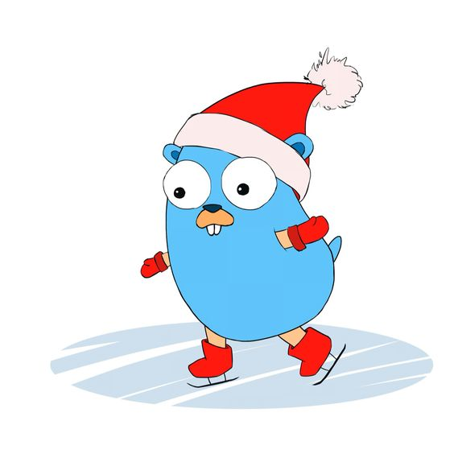
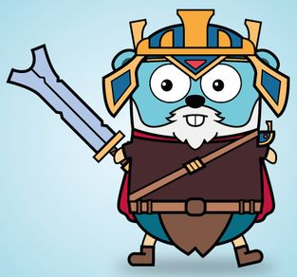


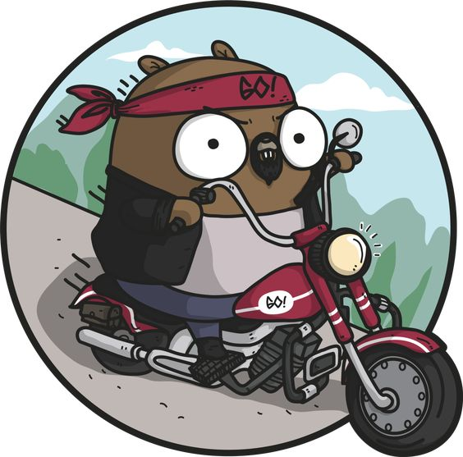



Slide 3

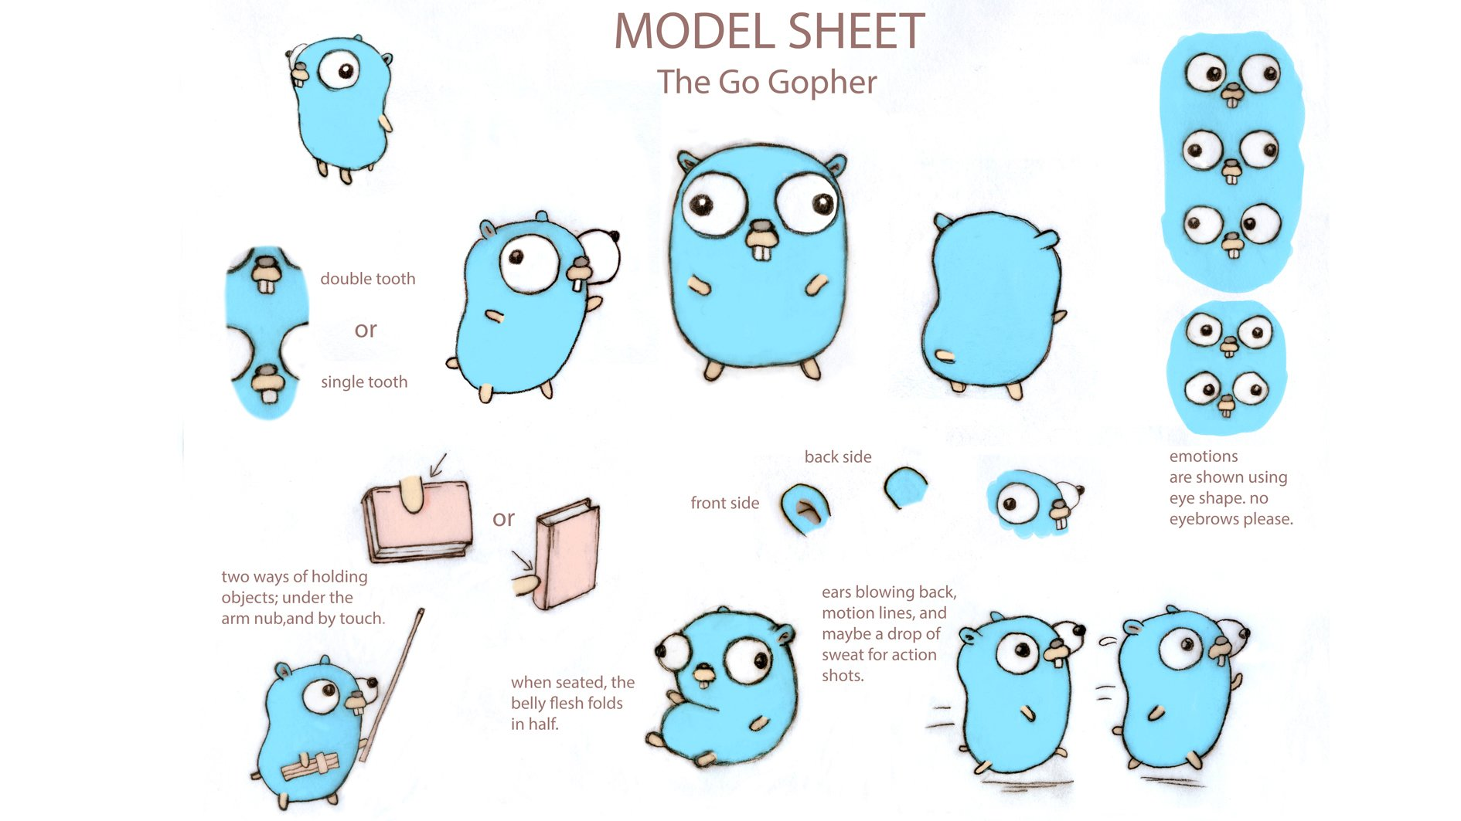

Slide 4

https://gopherize.me/

Slide 5
History :
Go was designed at Google in 2007
To improve programming productivity in an era of multicore,
networked machines and large codebases
Address criticisms of other languages
But
keep their useful characteristics

Slide 6
Static typing and run-time efficiency (like C)
Readability and usability (like Python)
High-performance networking and multiprocessing
(motivated by their shared dislike of C++)

Slide 7
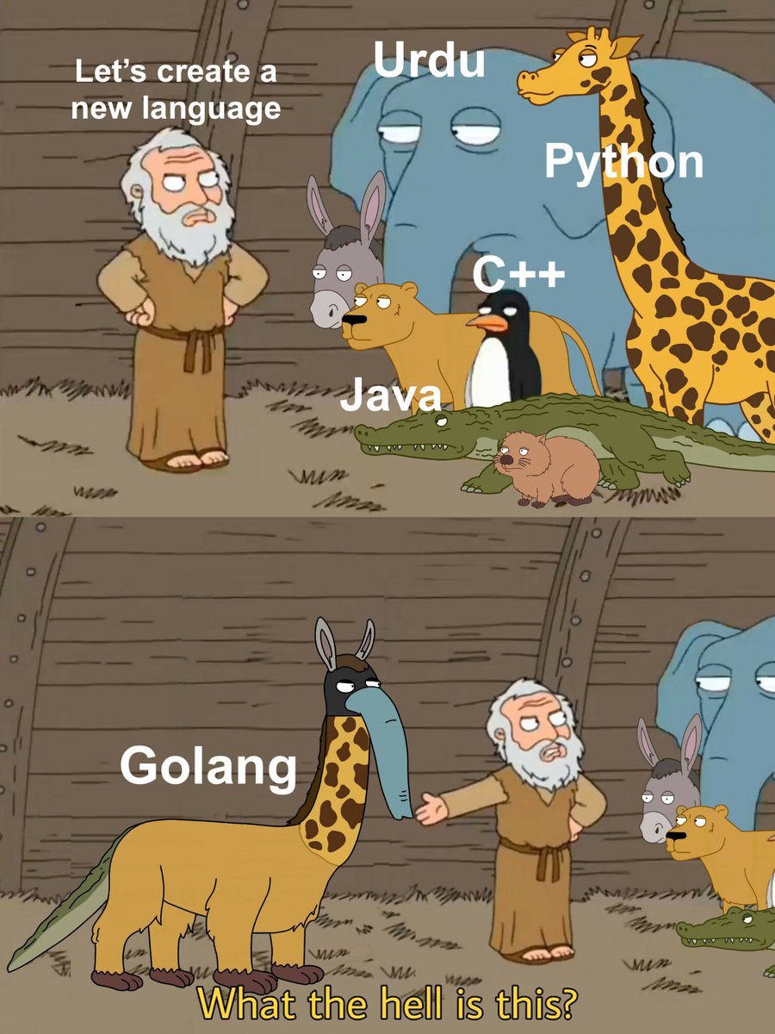

Slide 8
Developed by Robert Griesemer, Rob Pike, and Ken Thompson at Google.
Publicly announced in November 2009
Version 1.0 released in March 2012.
The Gopher mascot was introduced in 2009 for the open-source launch
of the language.
Designed by Renée French

Slide 9
JavaScript
Python
Java
Golang
Rust
C++
C
Assembly Language
Machine Language (0, 1)

Slide 10
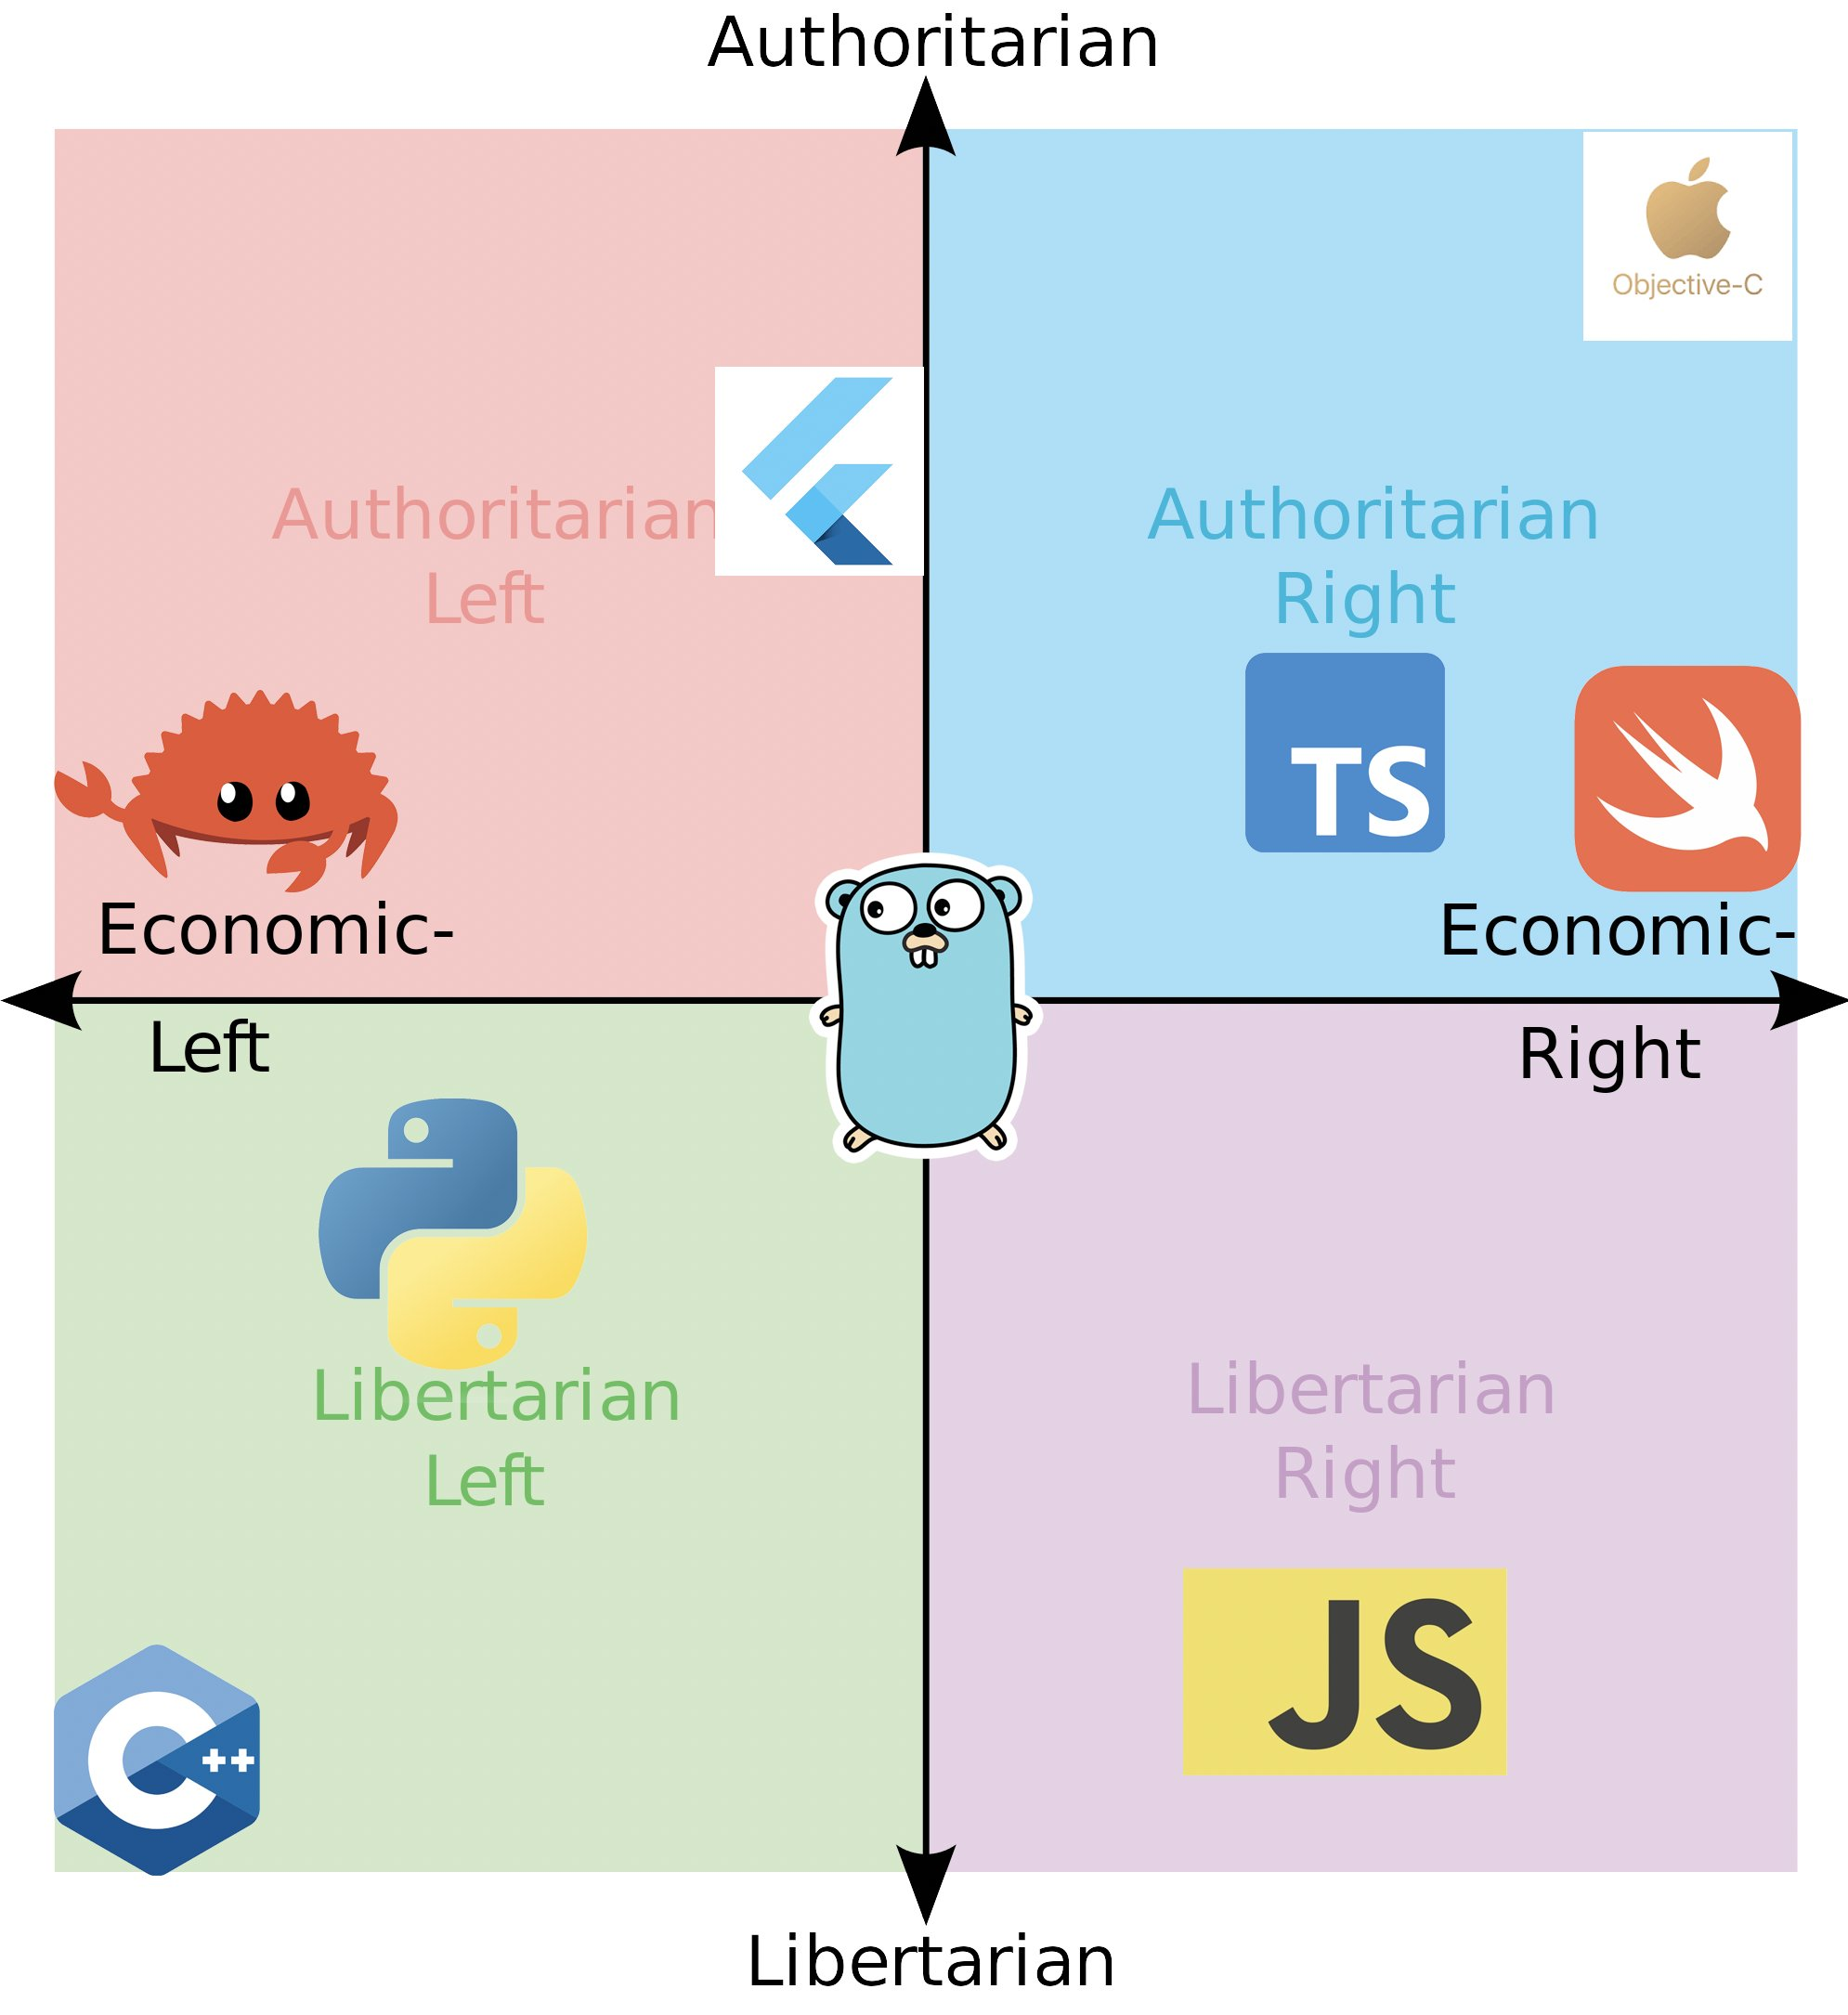

Slide 11
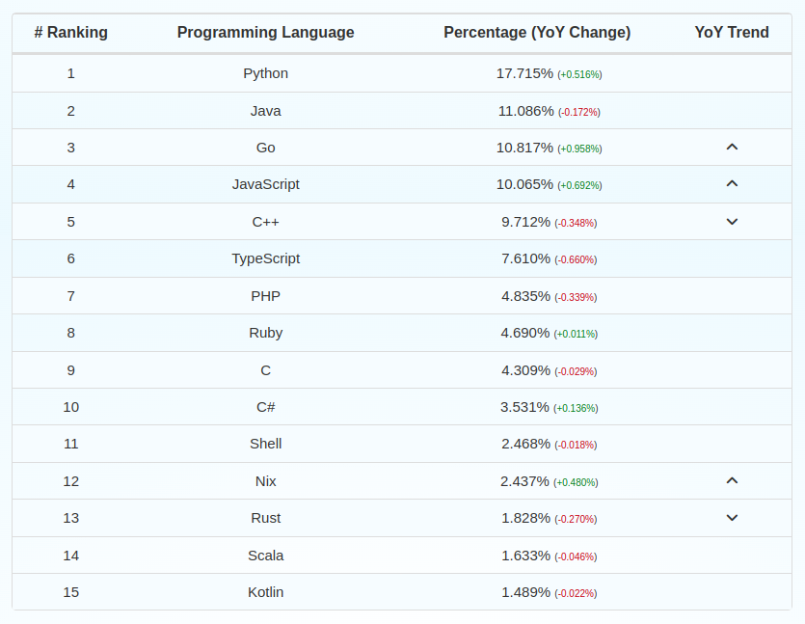

Slide 12


Slide 13
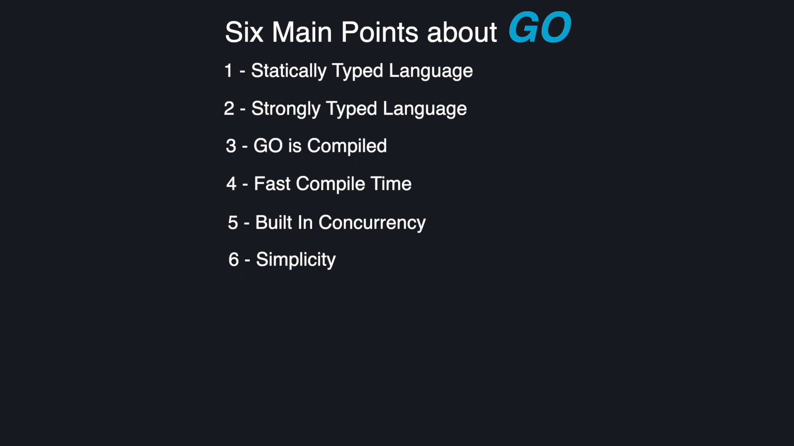

Slide 14
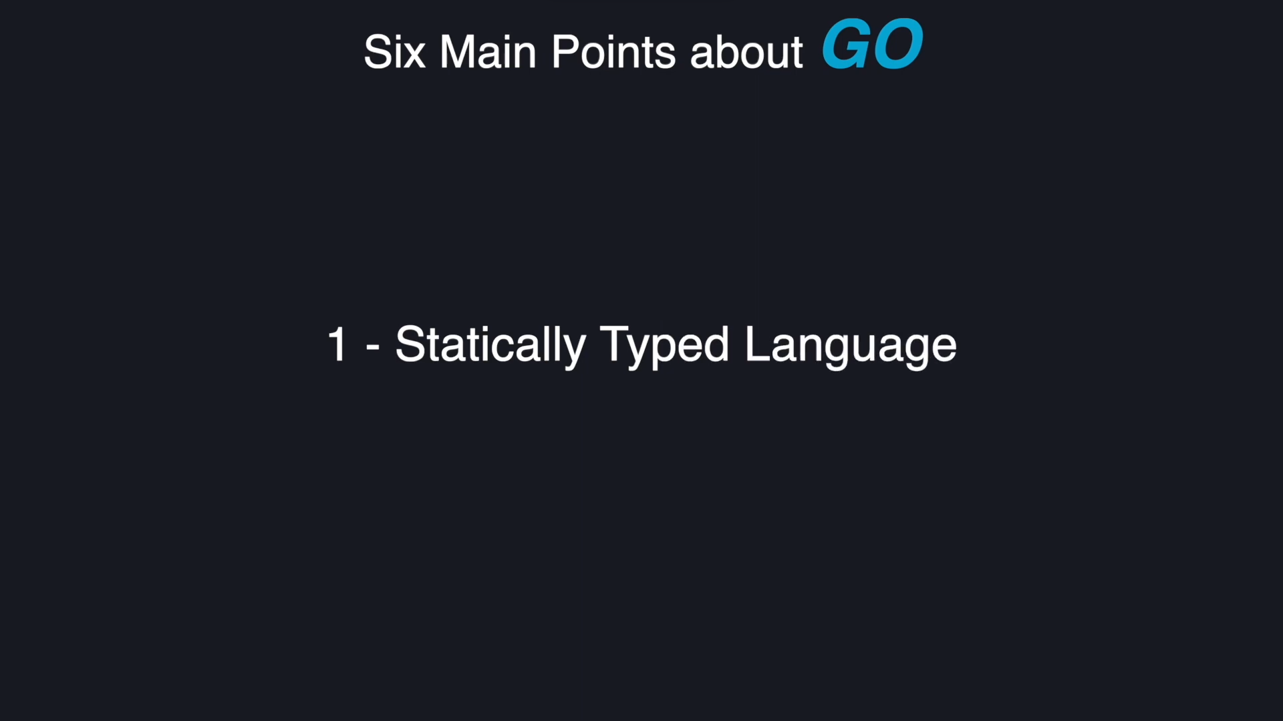

Slide 15
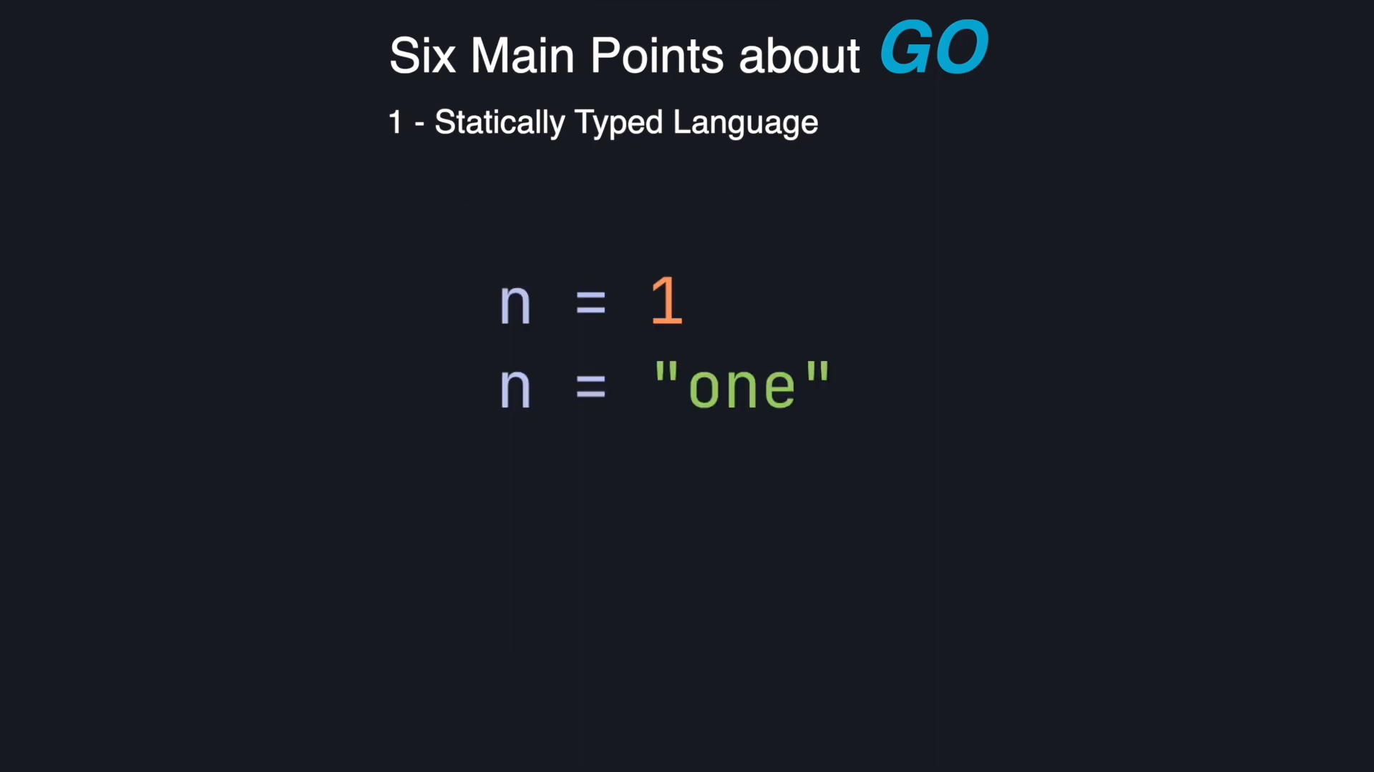

Slide 16
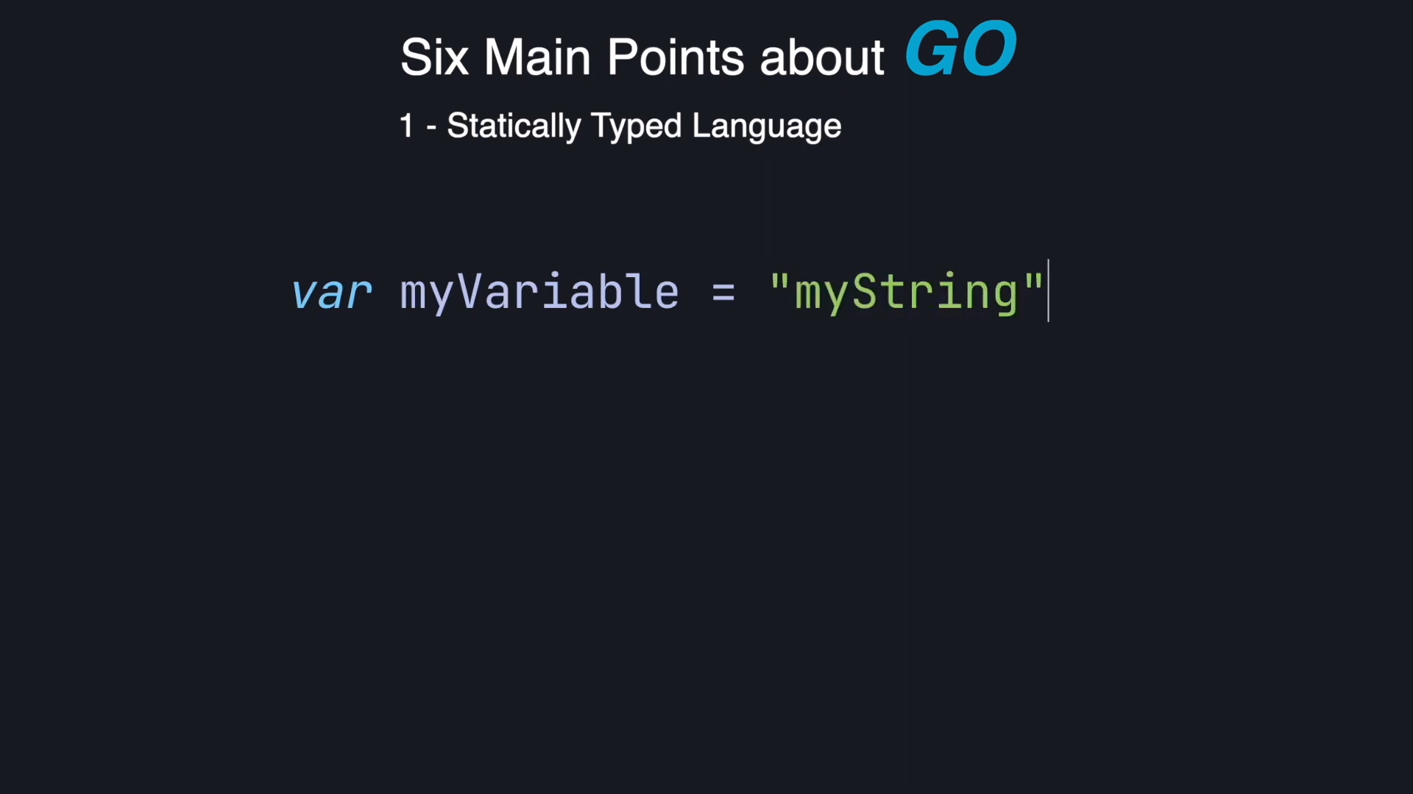

Slide 17
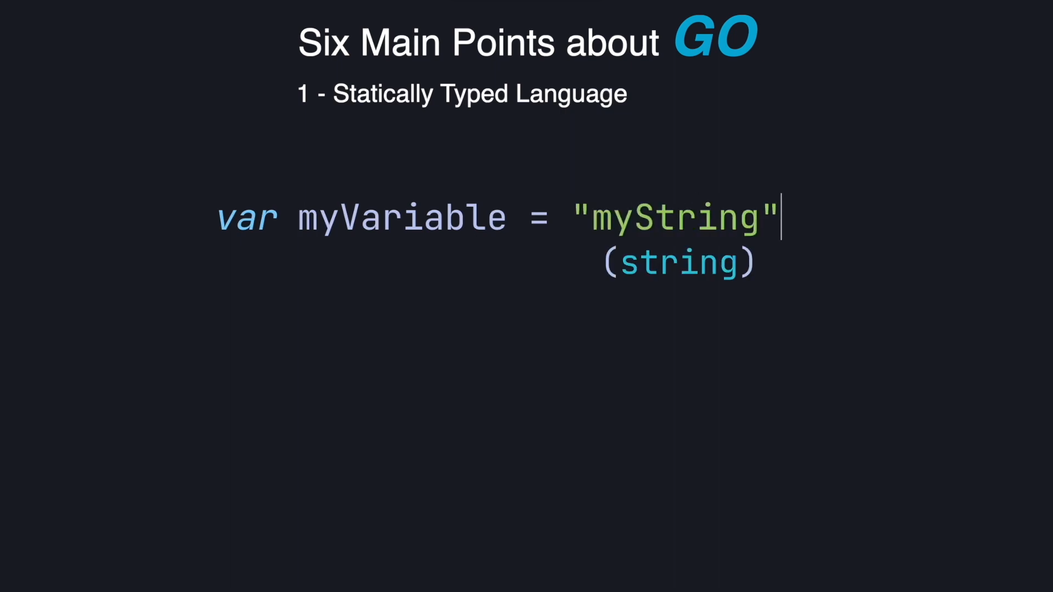

Slide 18
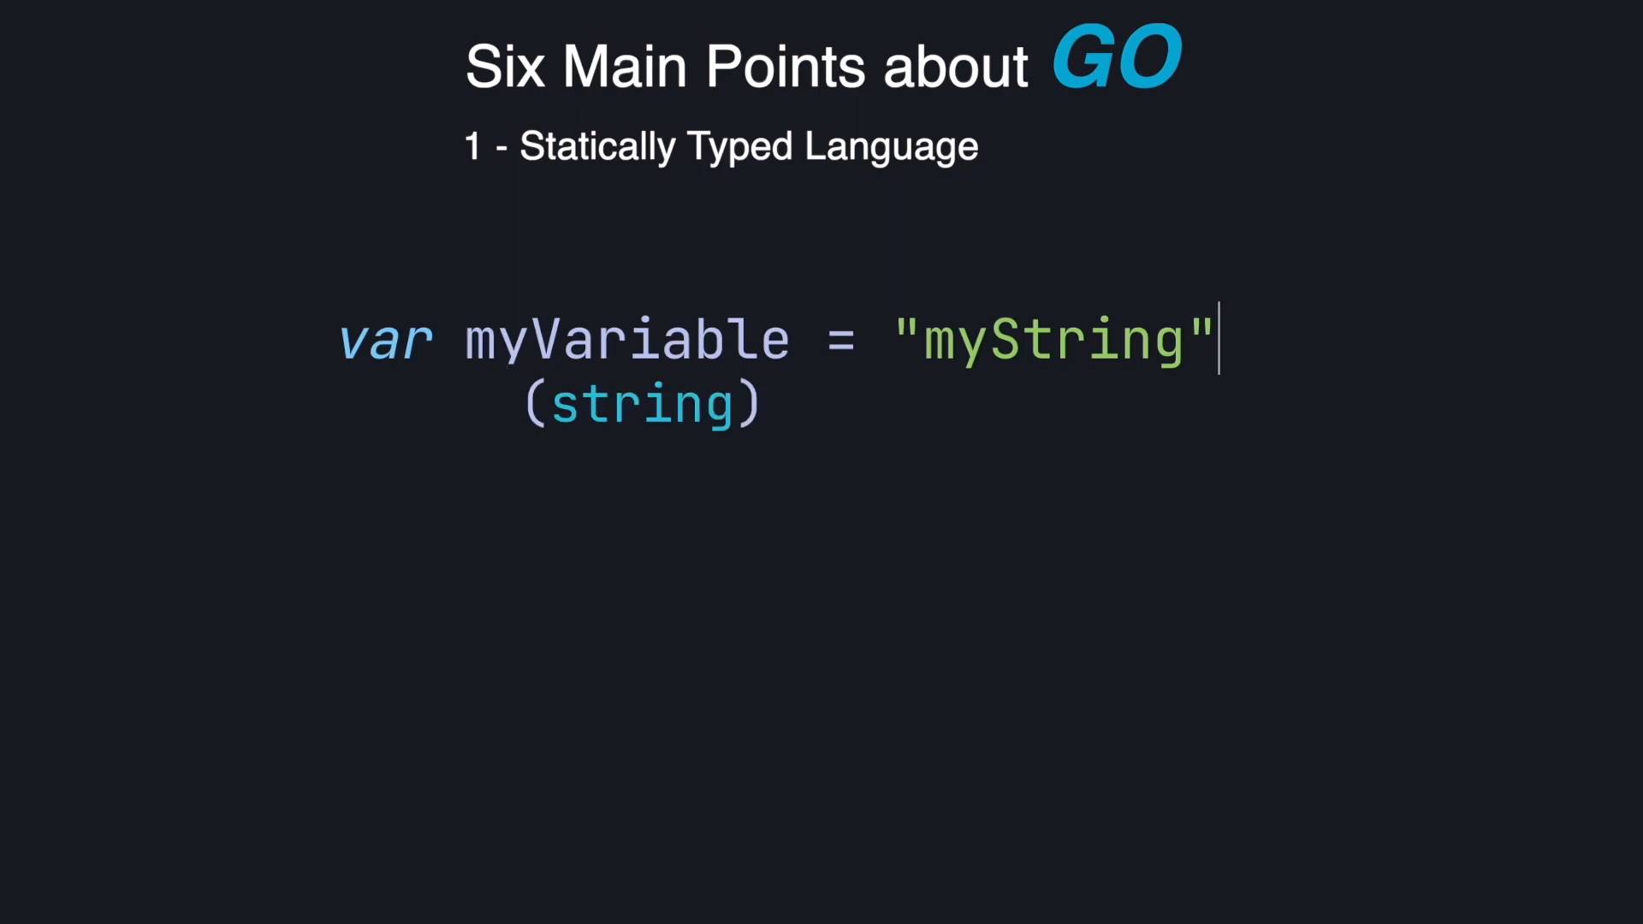

Slide 19
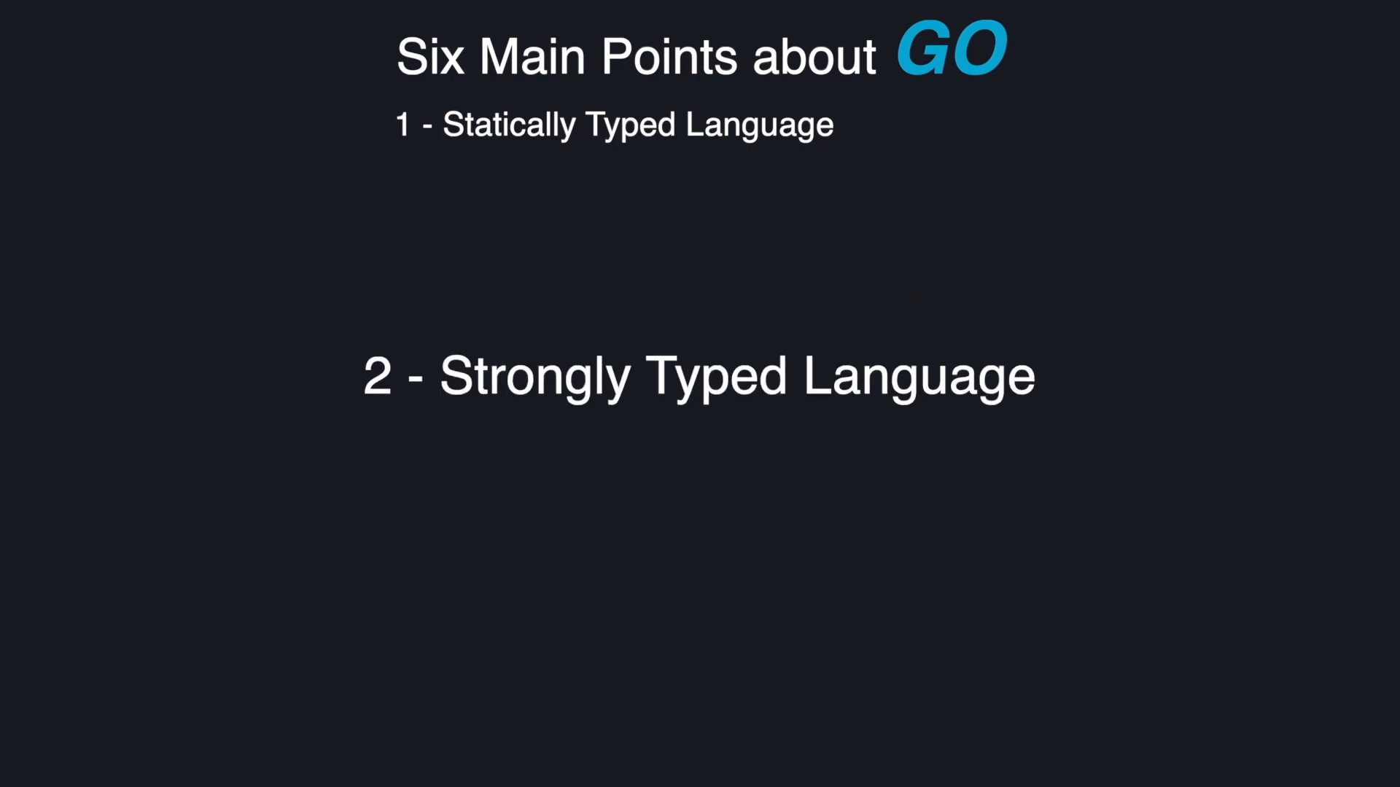

Slide 20
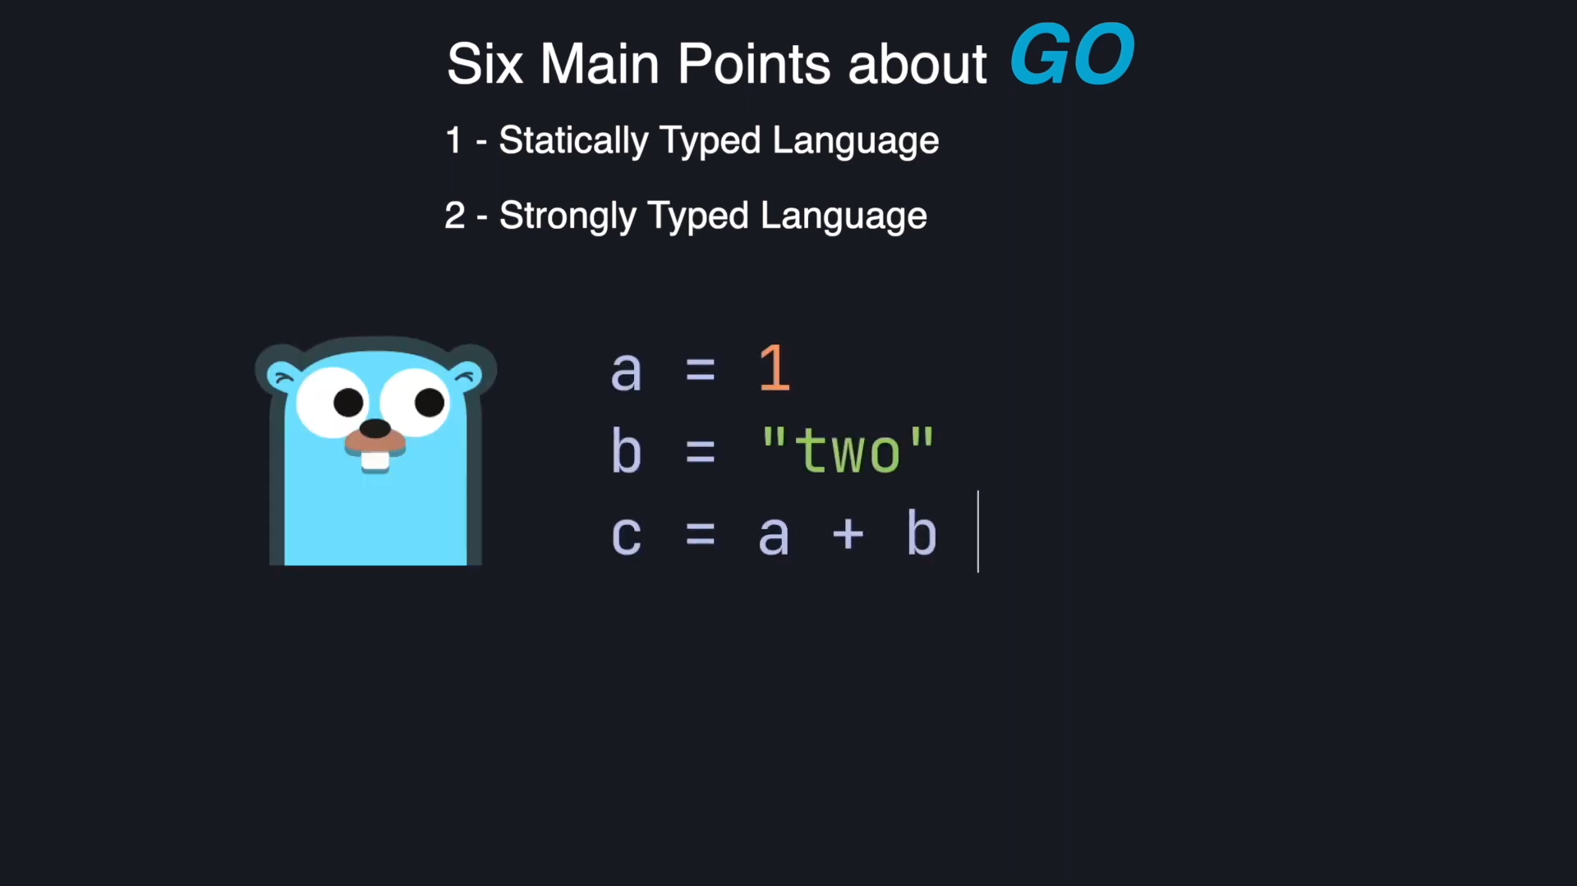

Slide 21
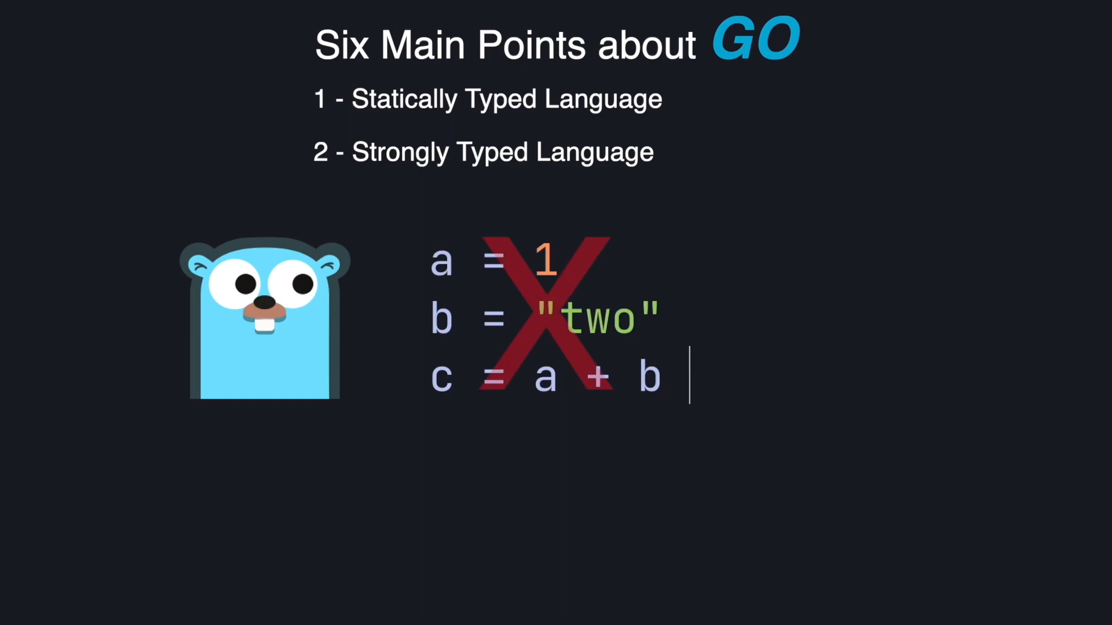

Slide 22
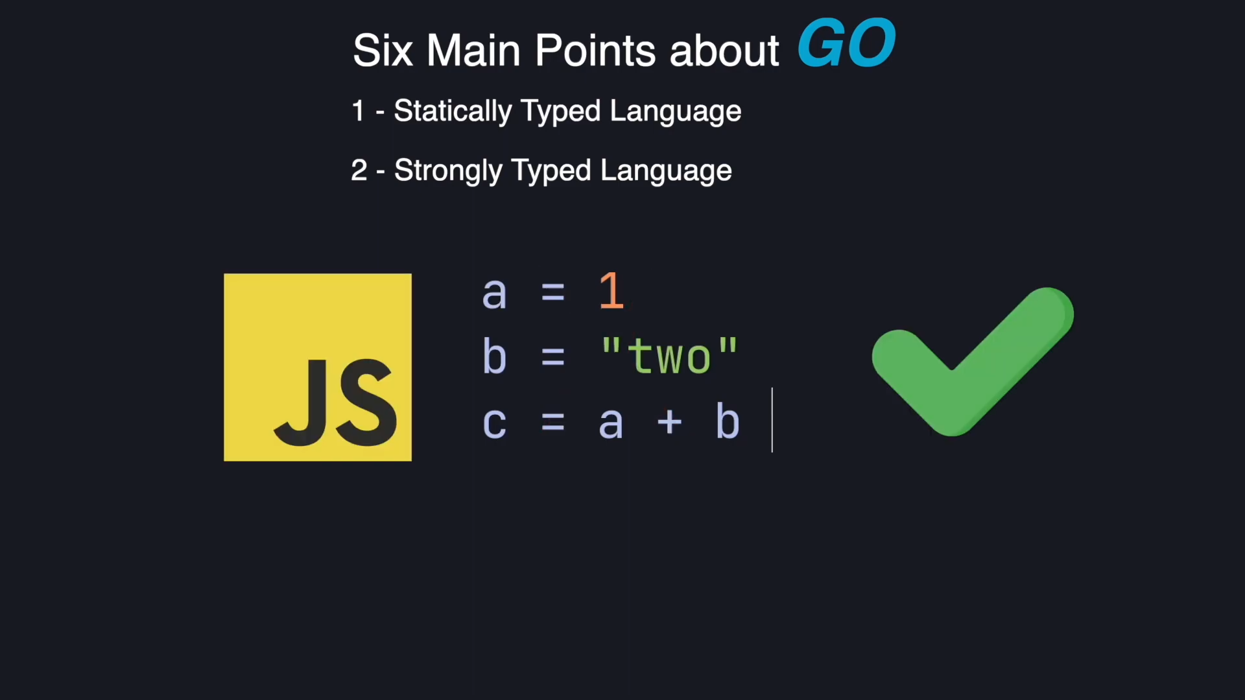

Slide 23
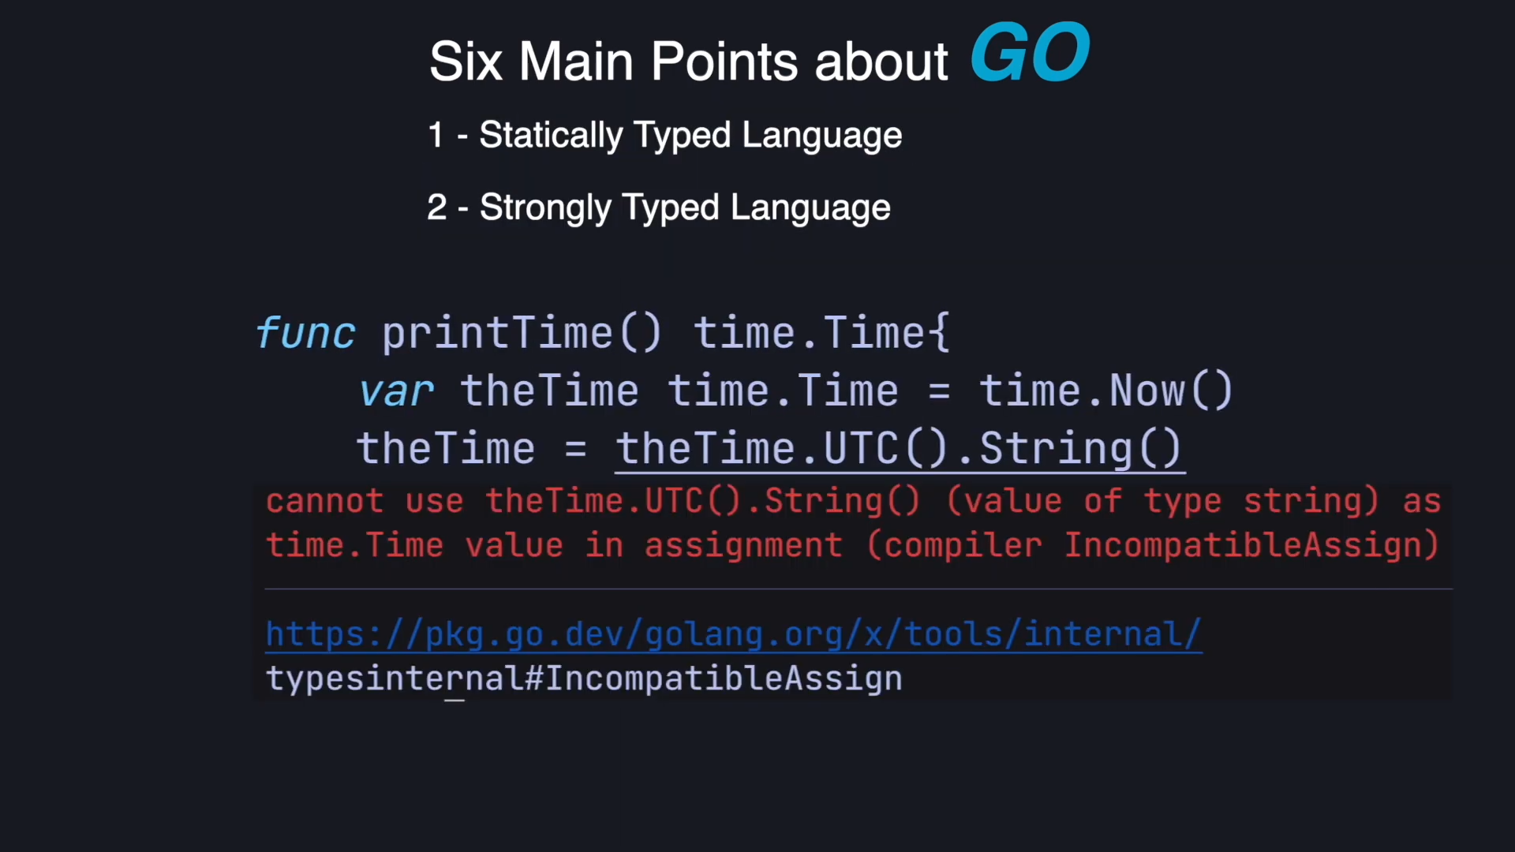

Slide 24
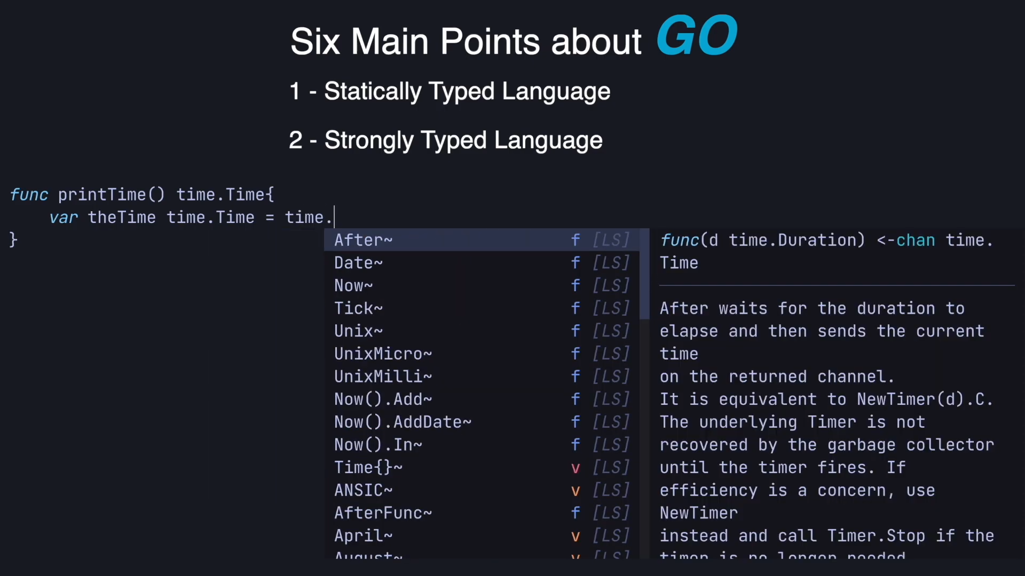

Slide 25
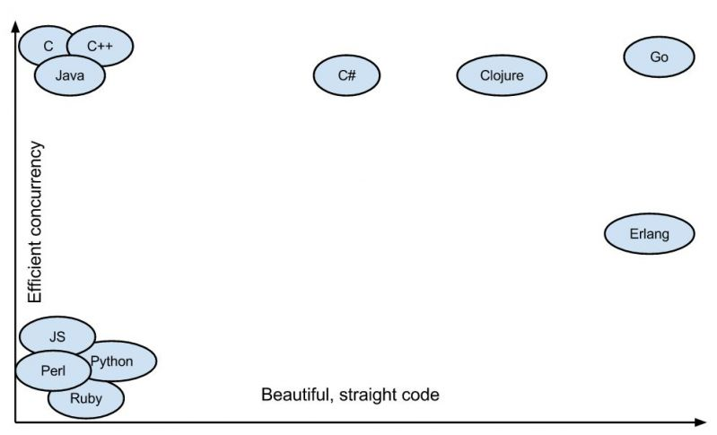

Slide 26
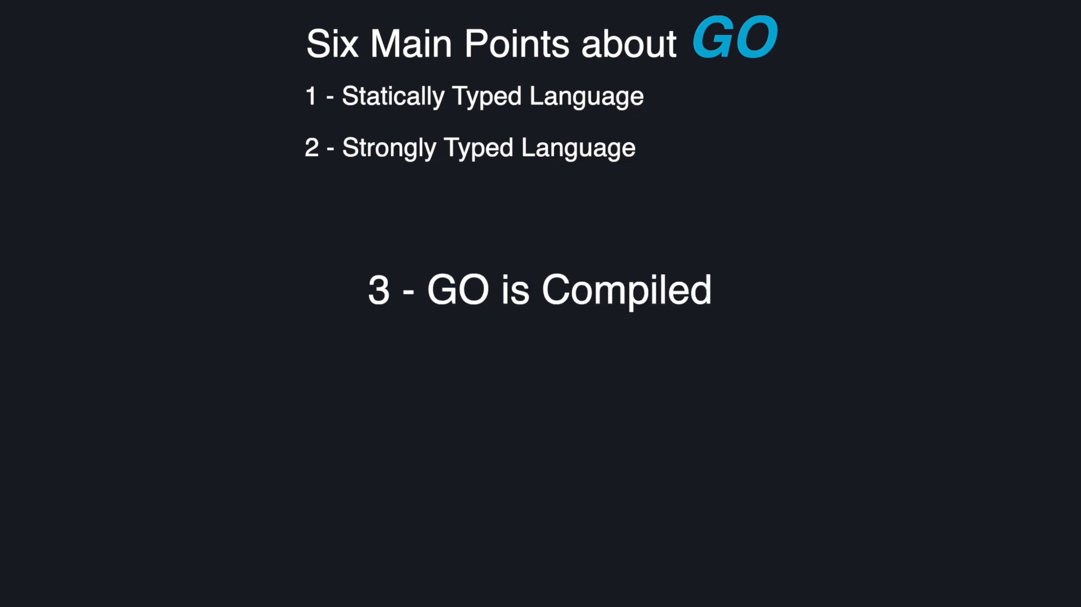

Slide 27
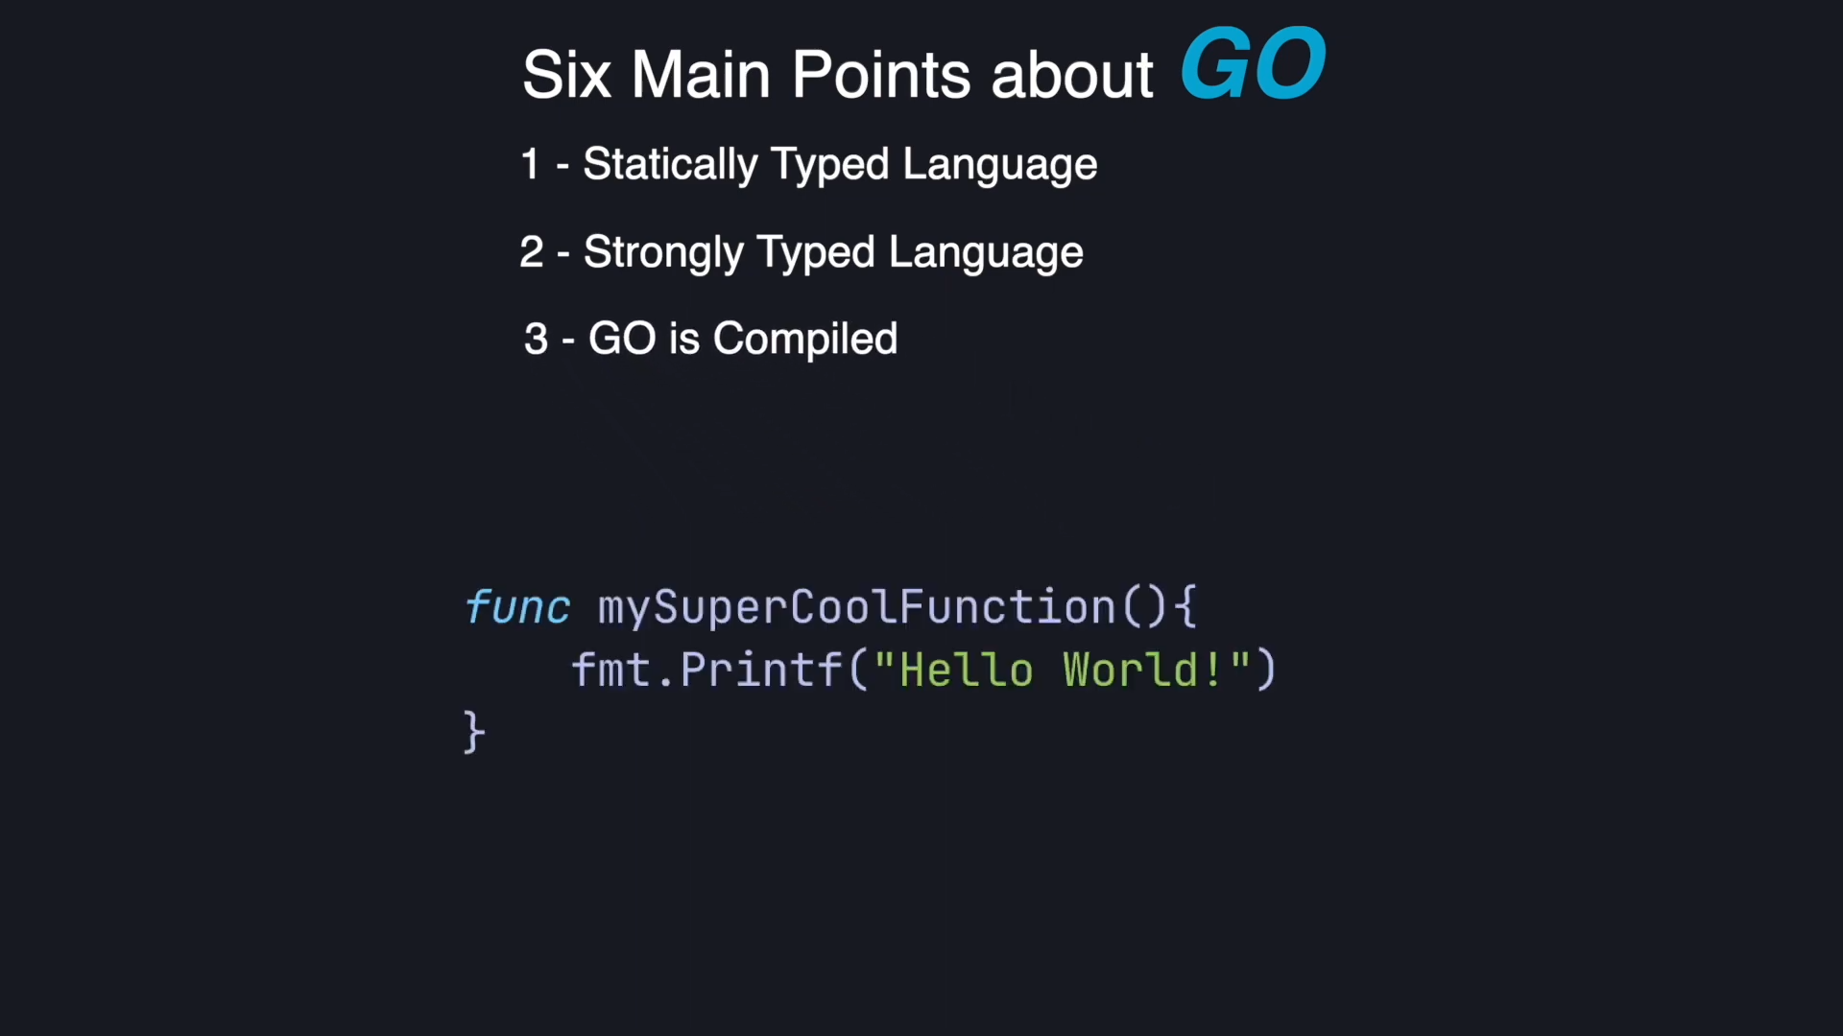

Slide 28
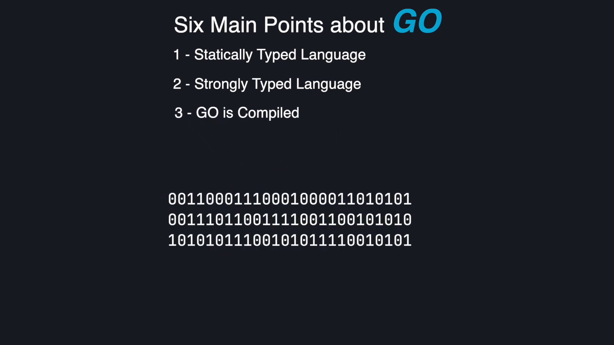

Slide 29
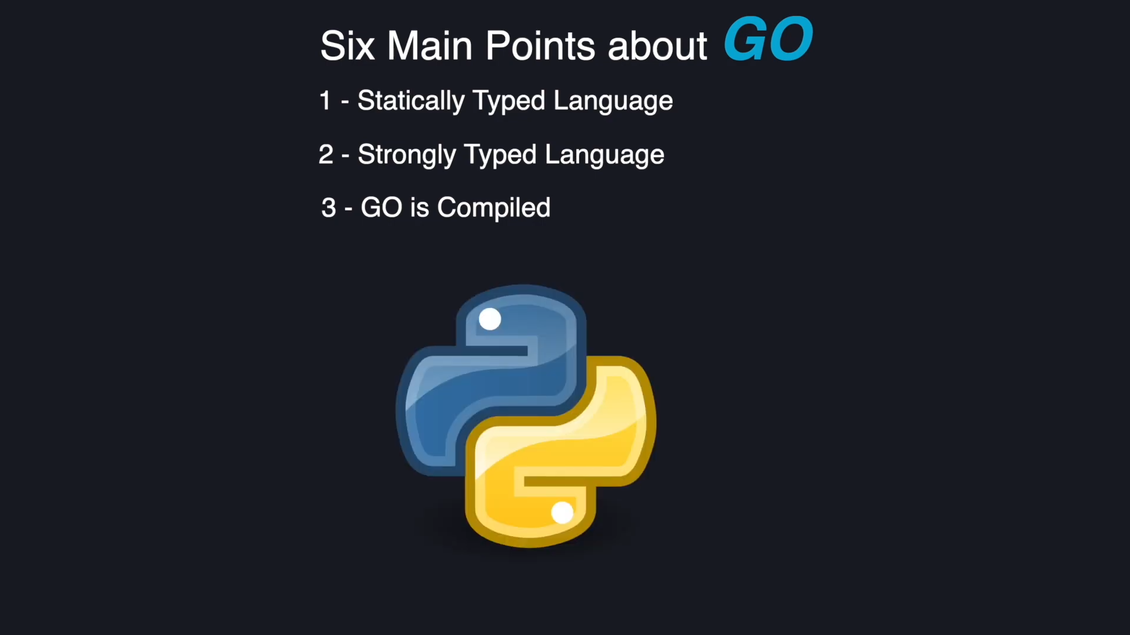

Slide 30
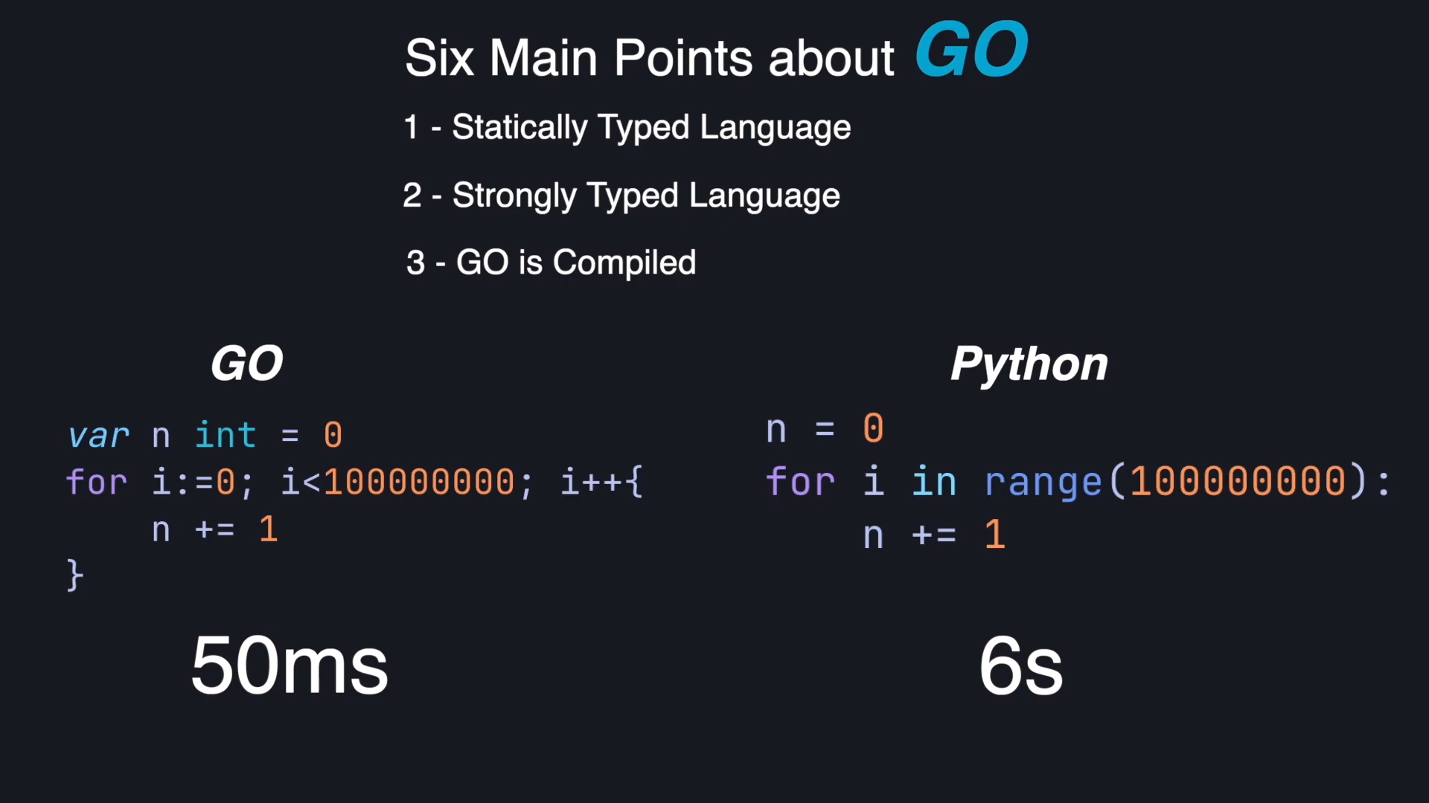

Slide 31
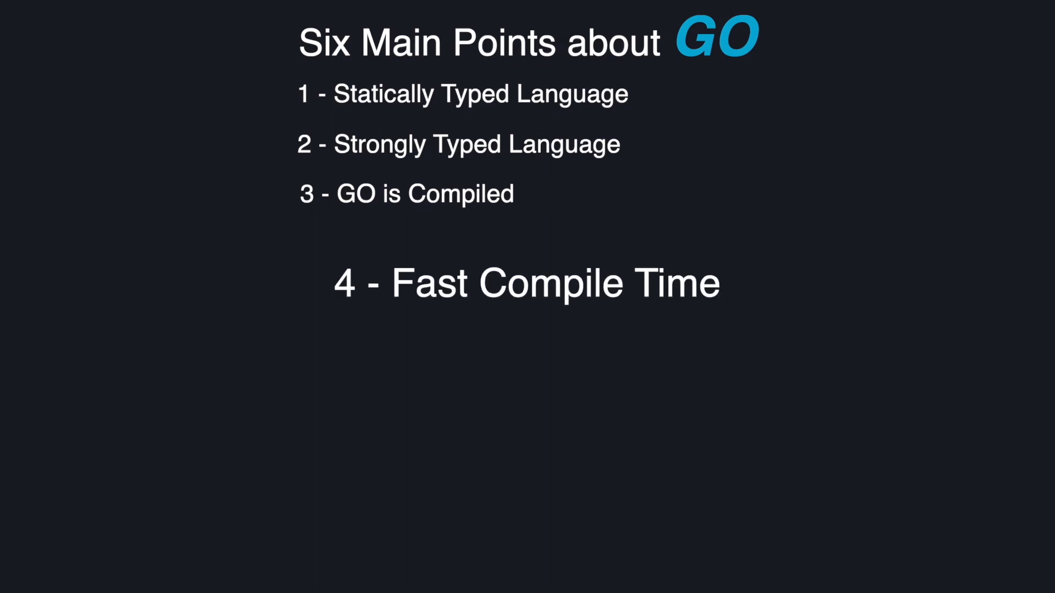

Slide 32
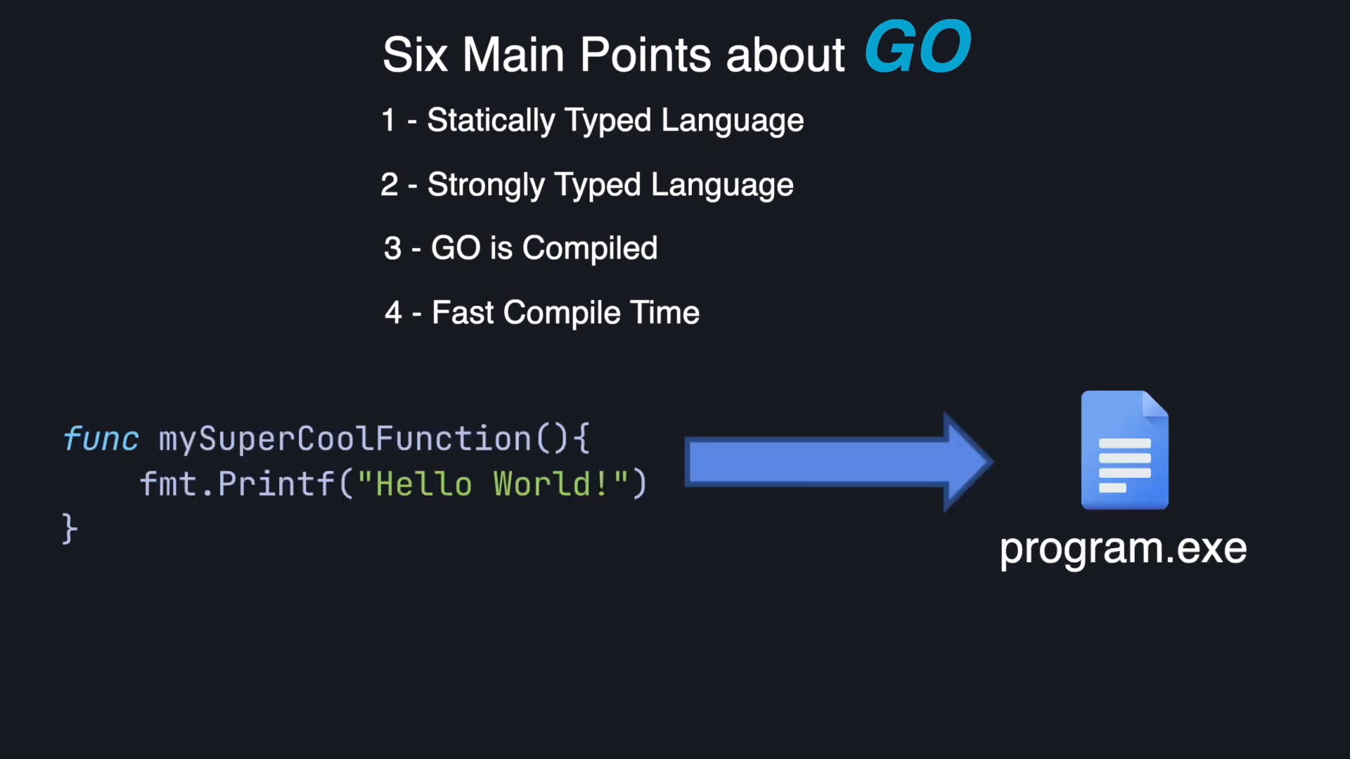

Slide 33
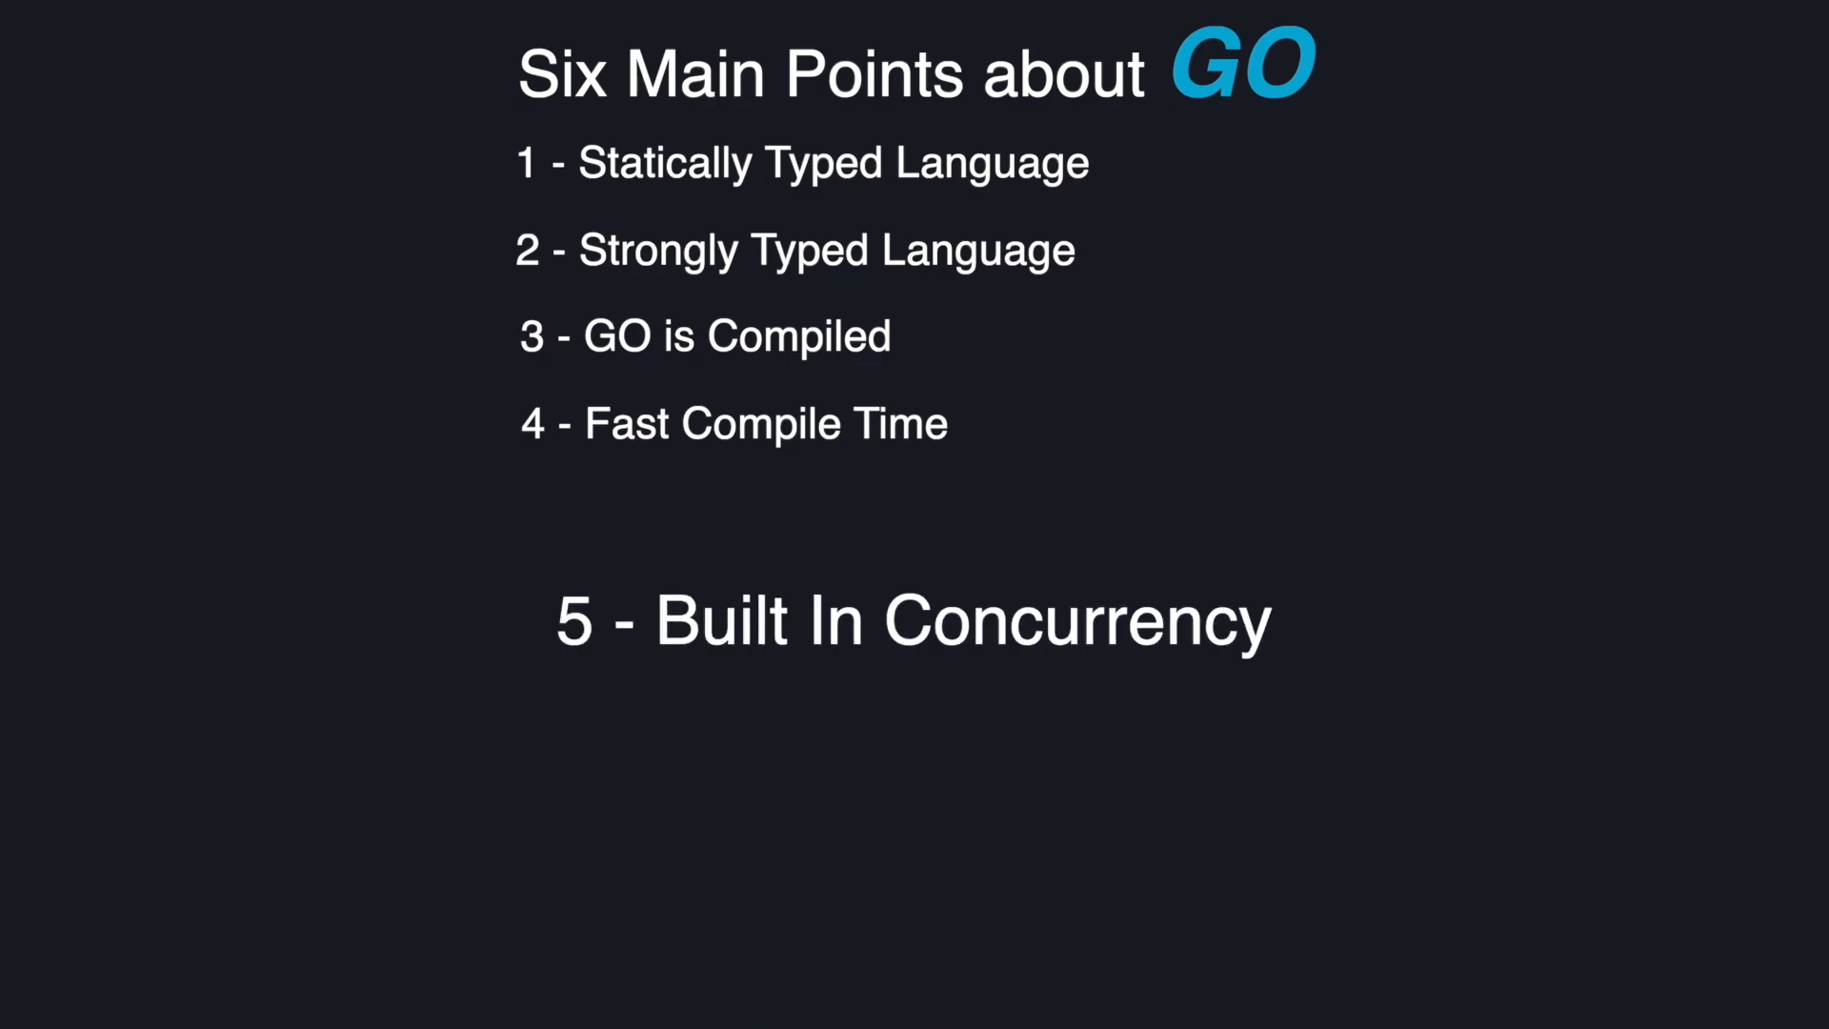

Slide 34
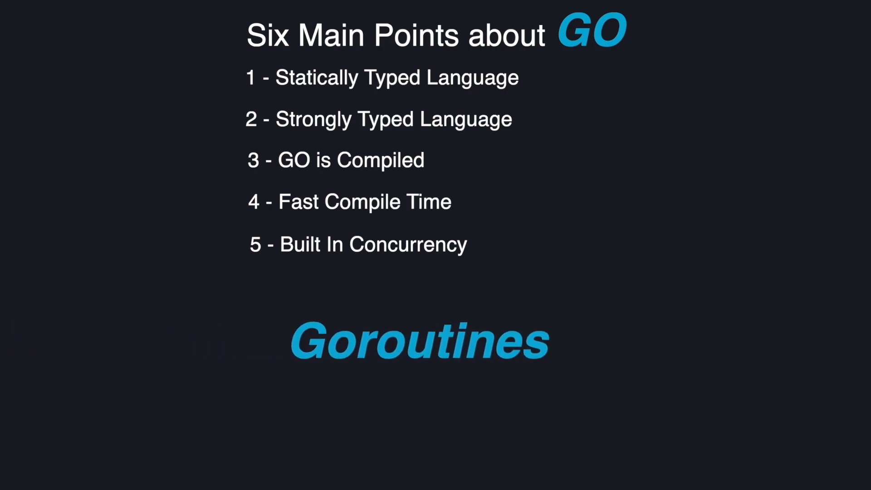

Slide 35
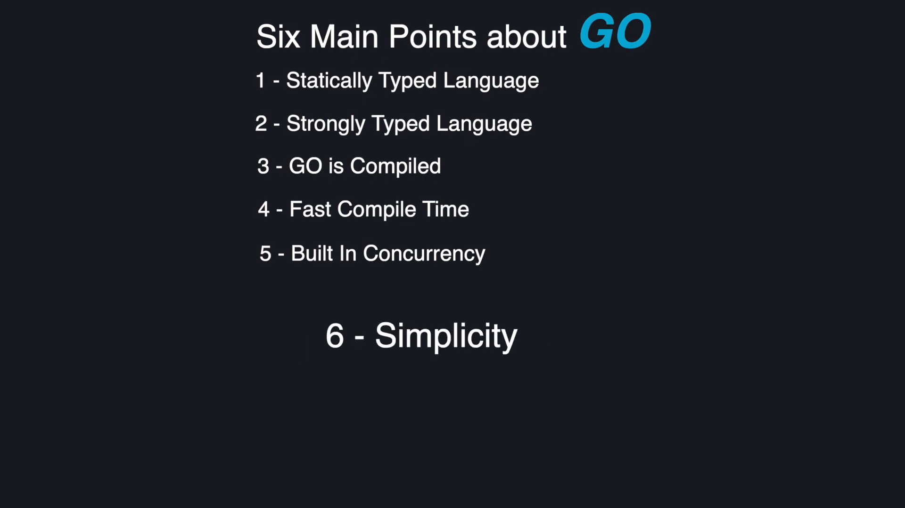
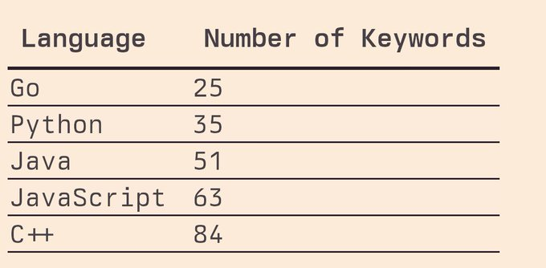

Slide 36
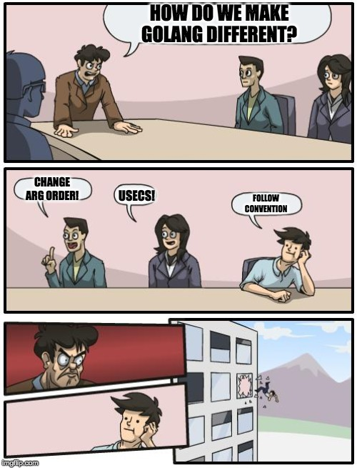

Slide 37
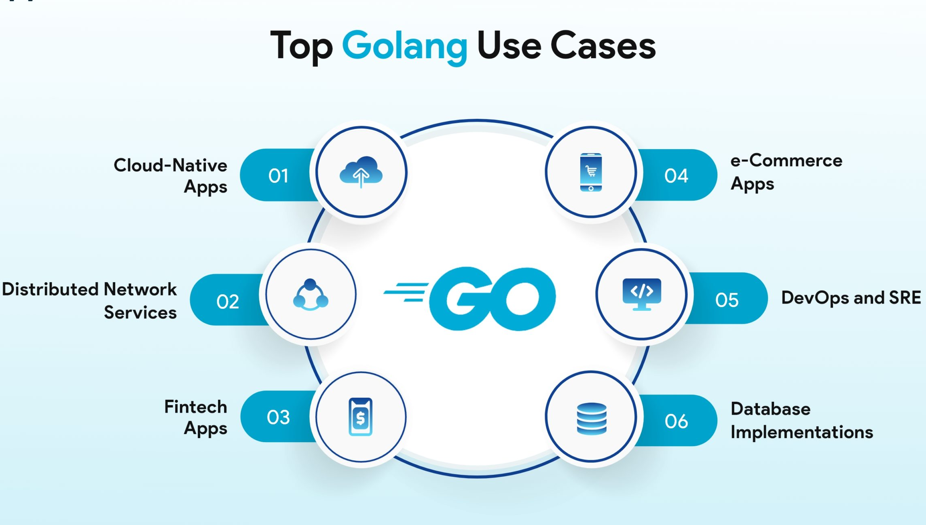
Use Cases

Slide 38

Golang in the Real World
Docker
Written in Go for performance and cross-platform support.
Efficiently manages containers, images, networking, and storage.
Revolutionized application packaging and deployment.

Slide 39

Golang in the Real World
Kubernetes
Utilizes Go's concurrency for cluster management.
Handles scheduling, scaling, and networking of containerized apps.
Standard for container arrangement in cloud-native environments.

Slide 40

Golang in the Real World
Terraform
Built with Go for simplicity and efficiency.
Enables infrastructure-as-code, managing resources across clouds.
Facilitates safe and scalable infrastructure provisioning.

Slide 41
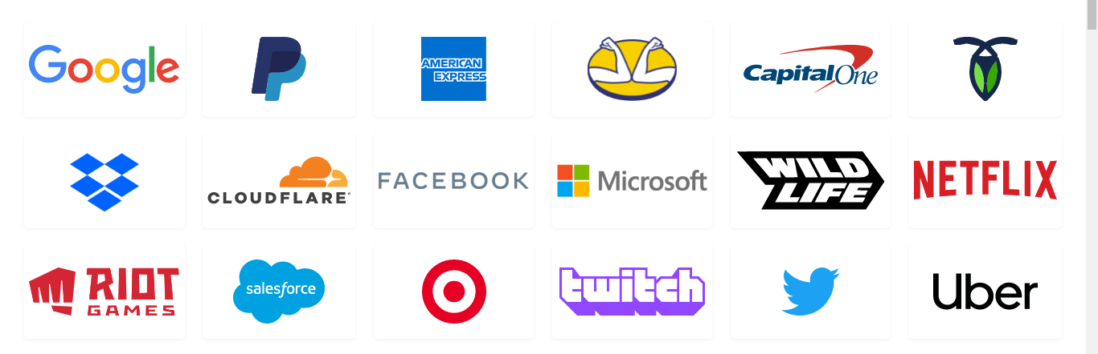
Golang in the Real World

Slide 42
Setting Up Development Environment

Slide 43
https://go.dev/dl/

Slide 44
Configuring environment variables:
System Variables > Path > Edit
New > C:\Program Files\Go\bin
go version

Slide 45
VS Code
Extensions > Go

Slide 46
Syntax Highlighting: Colourful formatting, improving readability.
IntelliSense (Code Completion): Smart suggestions
Code Navigation: Jump to function definitions, find references, etc.
Debugging: Set breakpoints, step through code, inspect variables to fix problems.
Linting: Automatic code analysis to catch potential errors early.
Formatting: Keep your code consistent and clean with automatic formatting.
Testing Support: Built-in tools to run and manage your Go tests.

Slide 47
https://go.dev/play/

Slide 49


Slide 50
Packages
Every Go program is made up of packages.
Programs start running in package main.

Slide 51
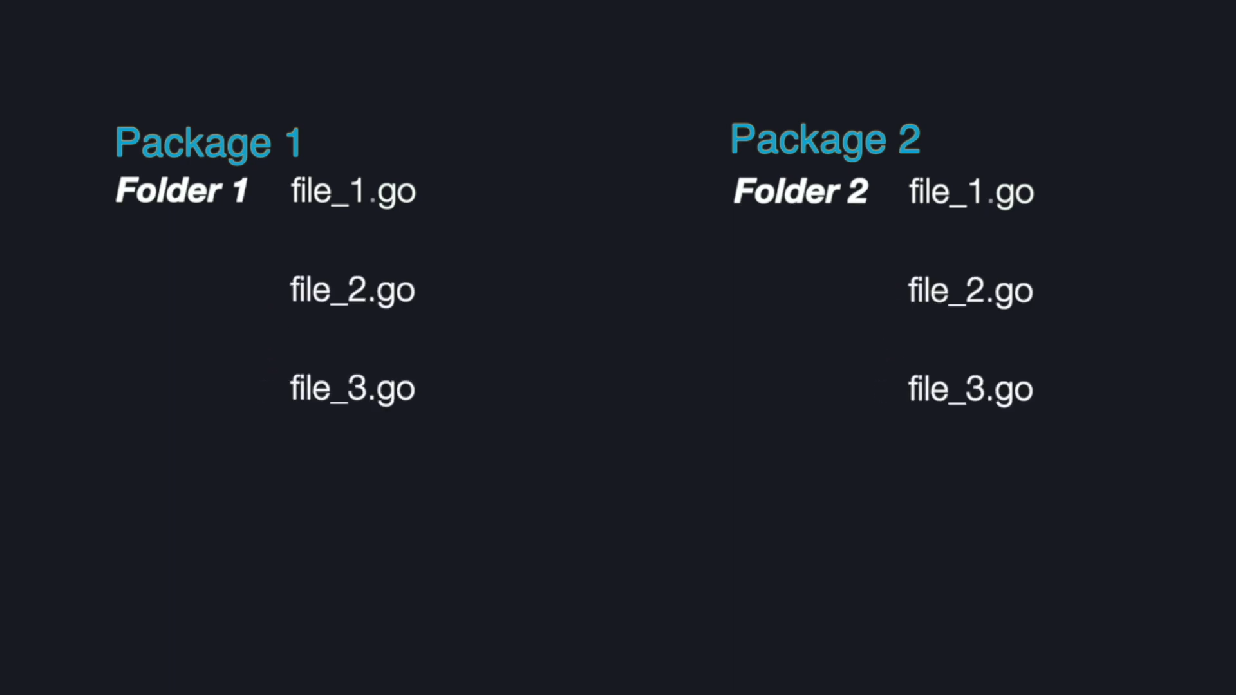

Slide 52
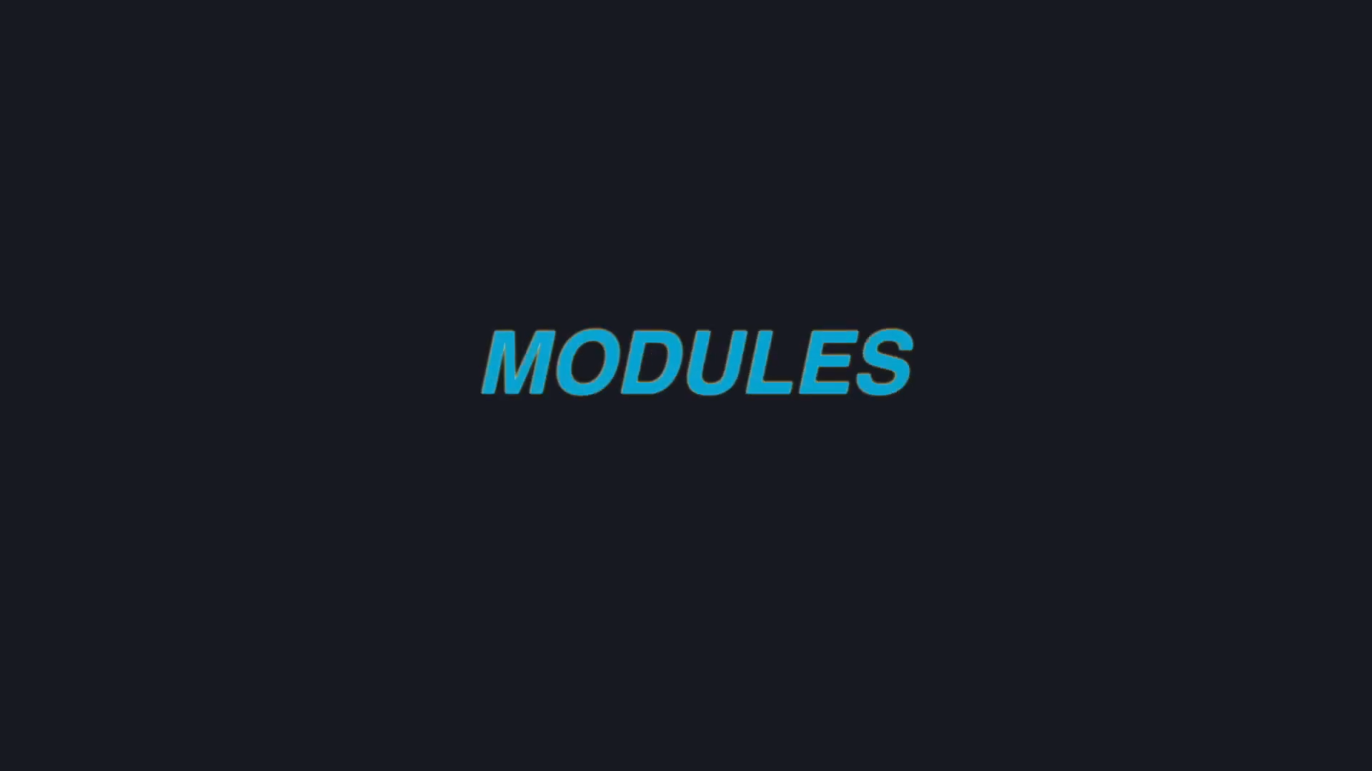

Slide 53
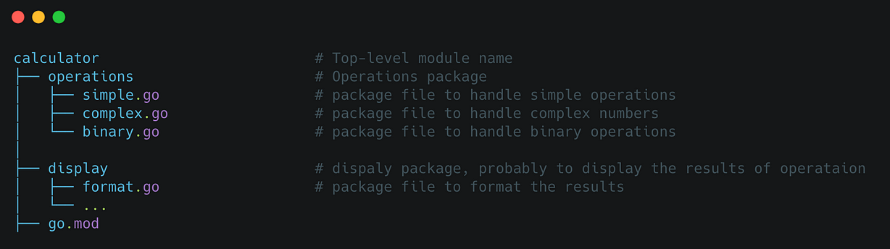

Slide 54
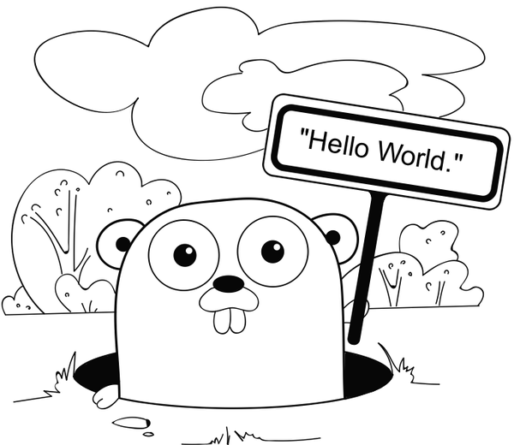
"Hello, World!"

Slide 55
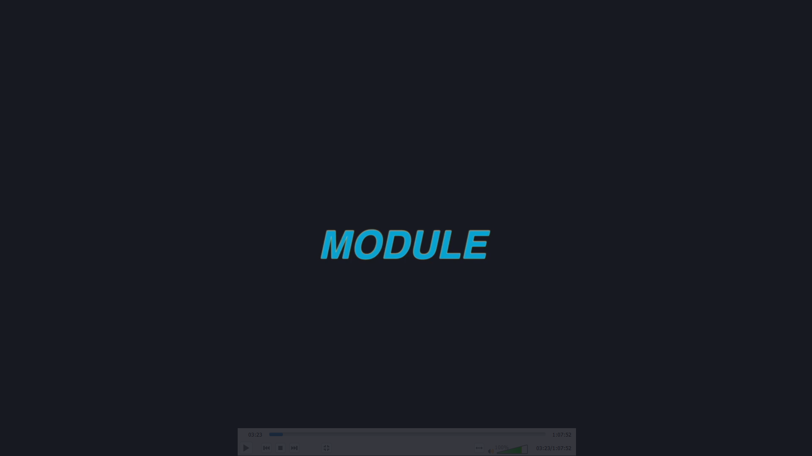
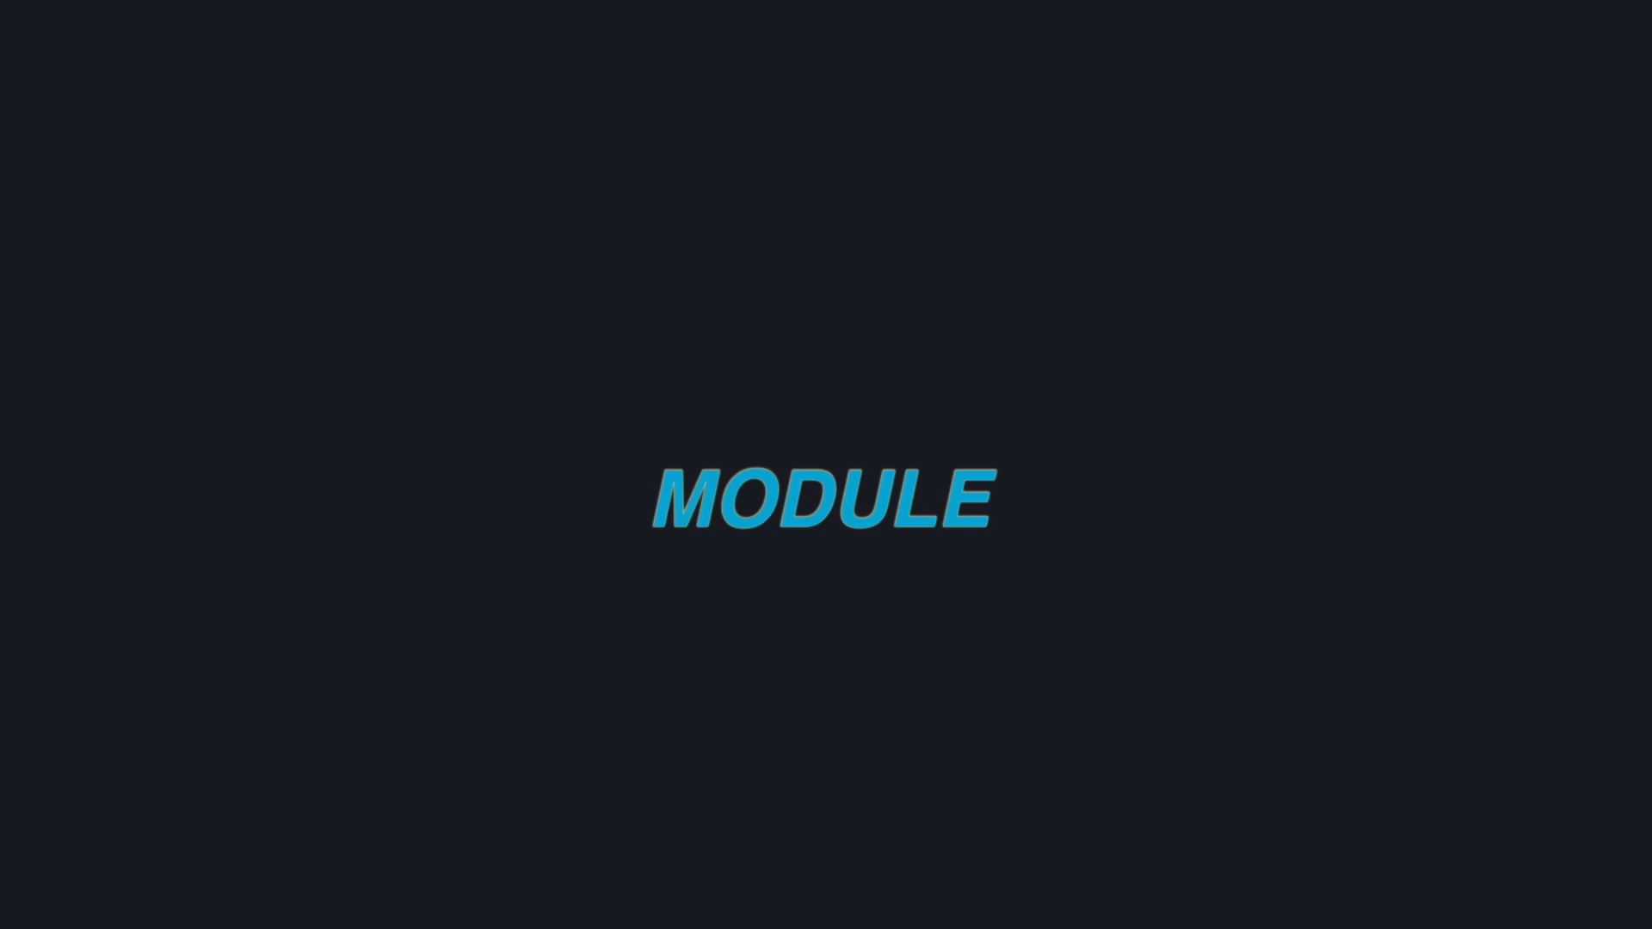



Slide 56
Variables:
var variableName dataType
The var statement declares a list of variables; as in function argument lists, the type is last.
A var declaration can include initializers, one per variable.
If an initializer is present, the type can be omitted; the variable will take the type of the initializer.

Slide 57
Variables:
Zero values
Variables declared without an explicit initial value are given their zero value.
The zero value is:
0 for numeric types,
false for the boolean type, and
"" (the empty string) for strings.

Slide 58
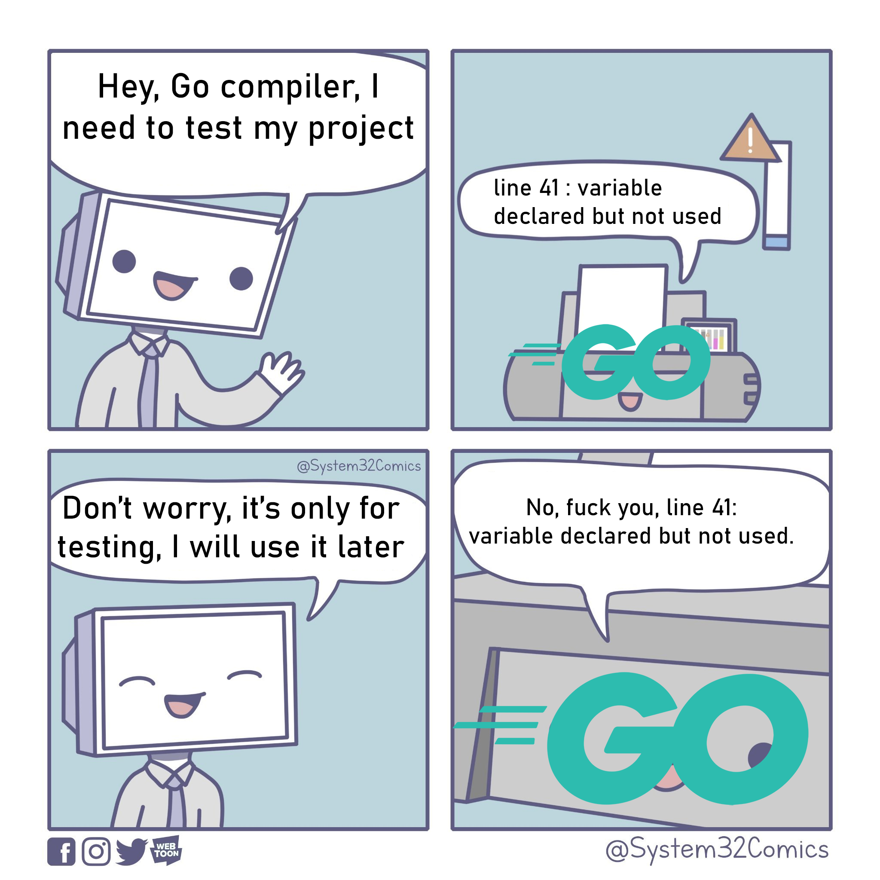
Variables:

Slide 59
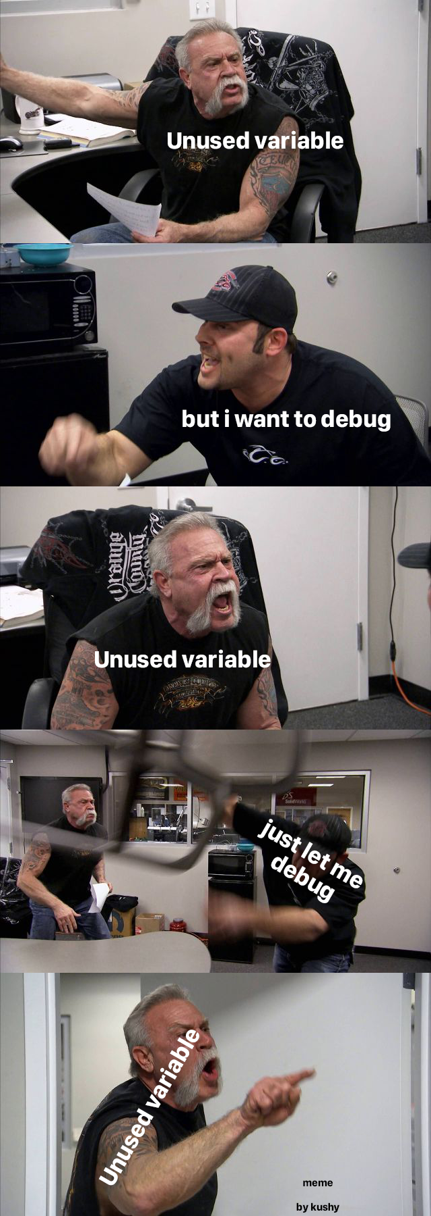
Variables:

Slide 60
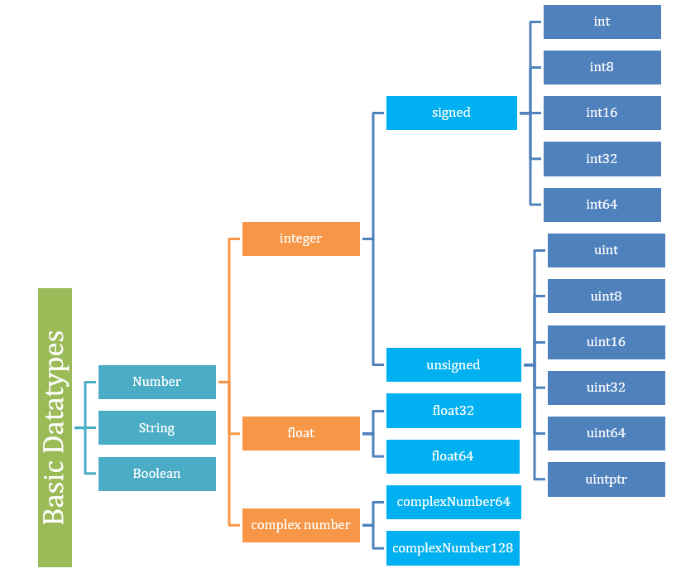
Datatypes:

Slide 61
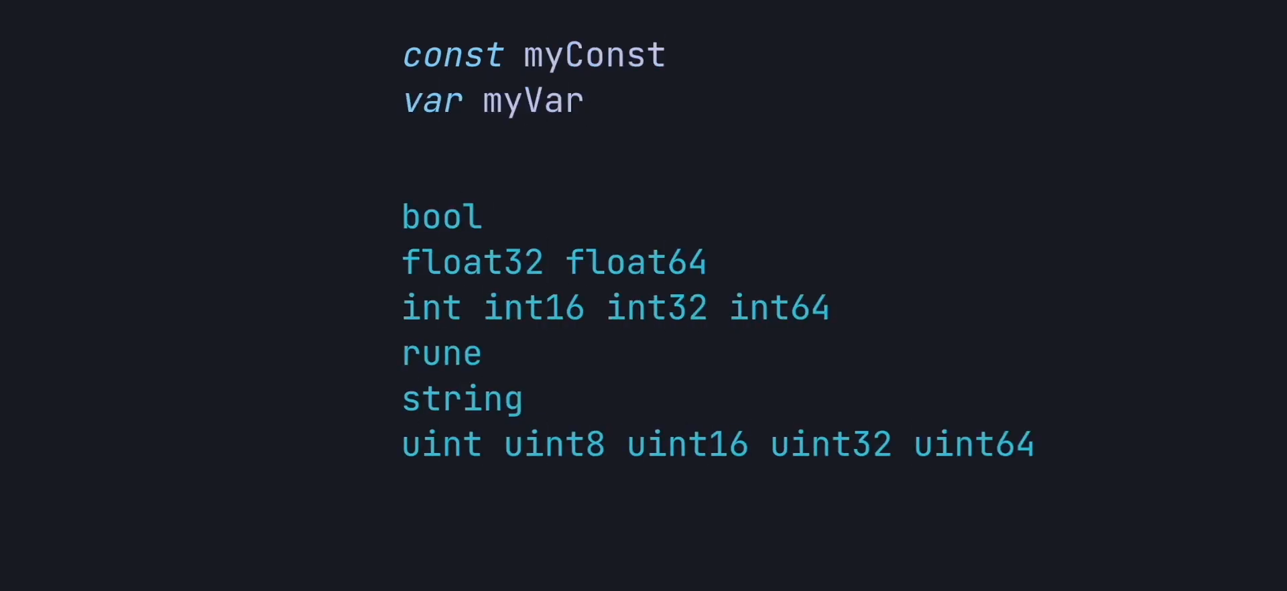

Slide 62
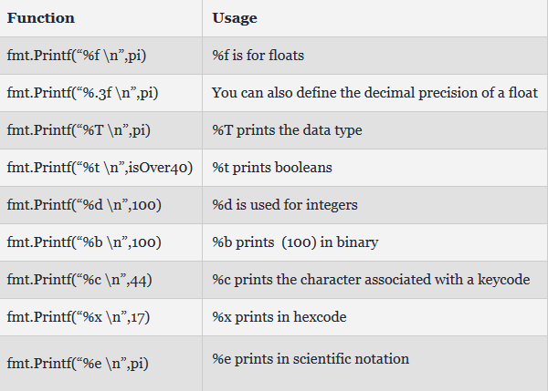

Slide 63
String:
var str string
str = "Hello, World!“
str := "Hello, World!"
length := len(str)
char := str[index]

Slide 64
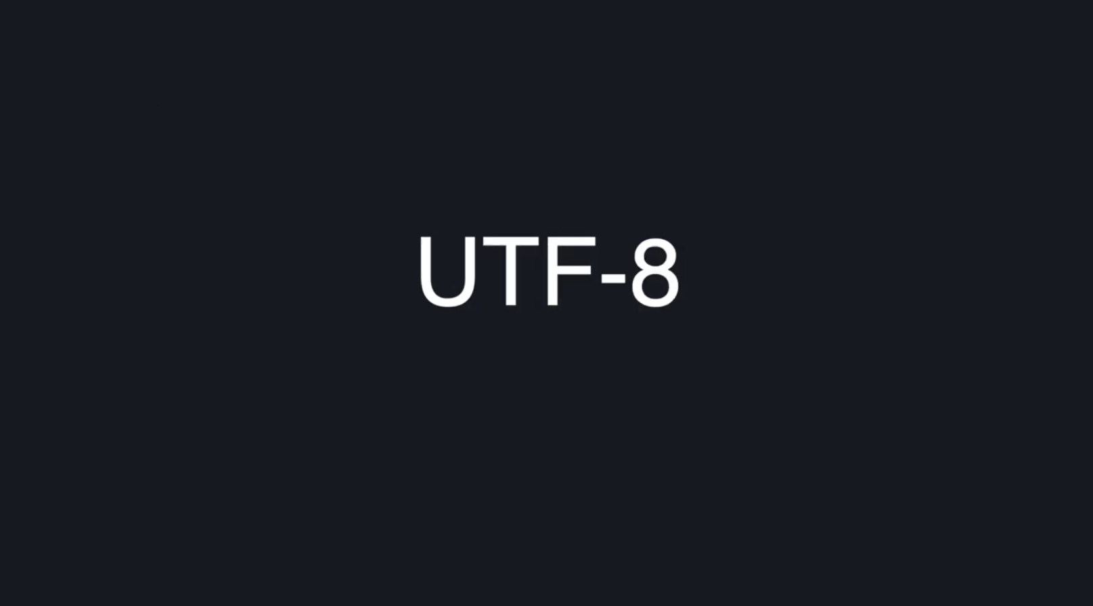
String:

Slide 65
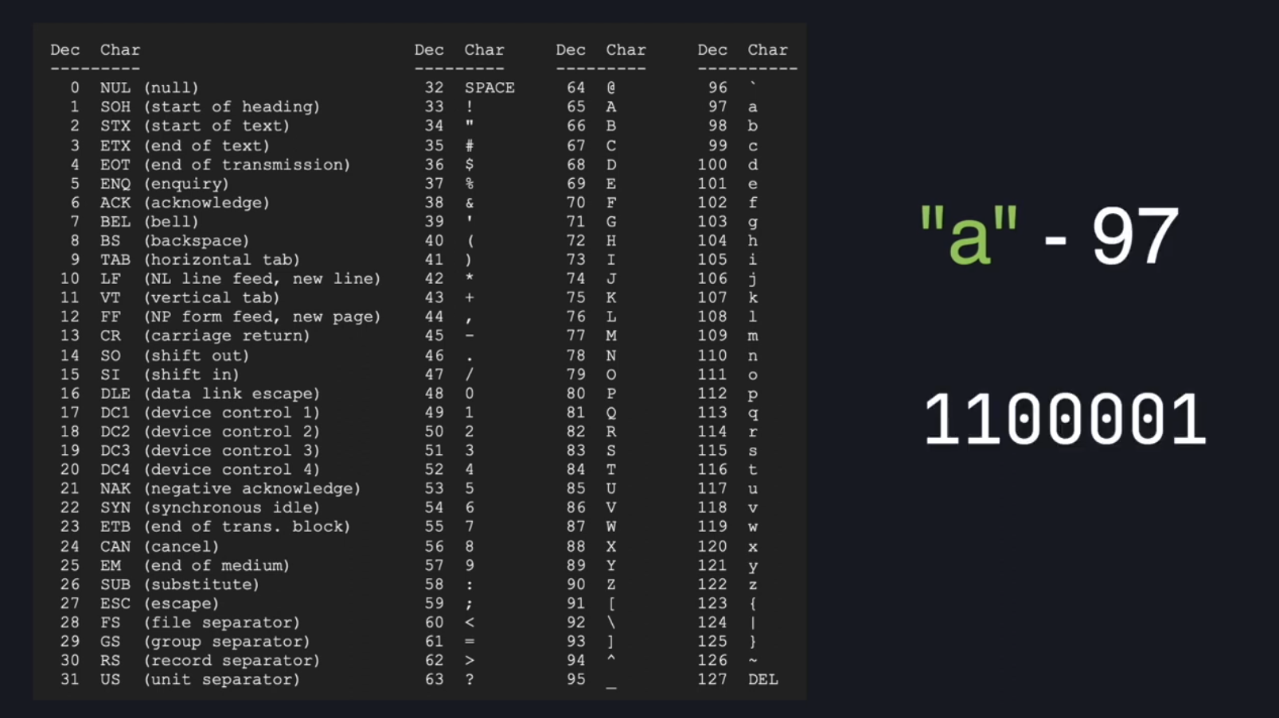
String:
var str string
str = "Hello, World!“
str := "Hello, World!"
length := len(str)
char := str[index]

Slide 66
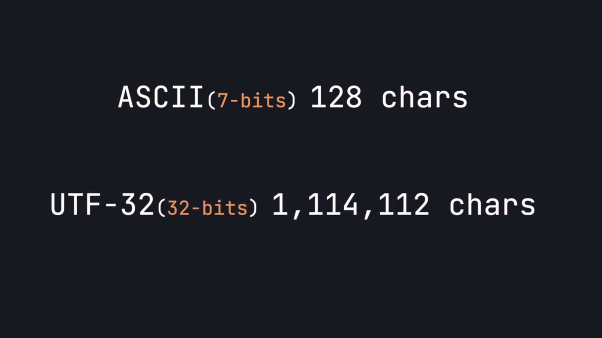
String:
var str string
str = "Hello, World!“
str := "Hello, World!"
length := len(str)
char := str[index]

Slide 67
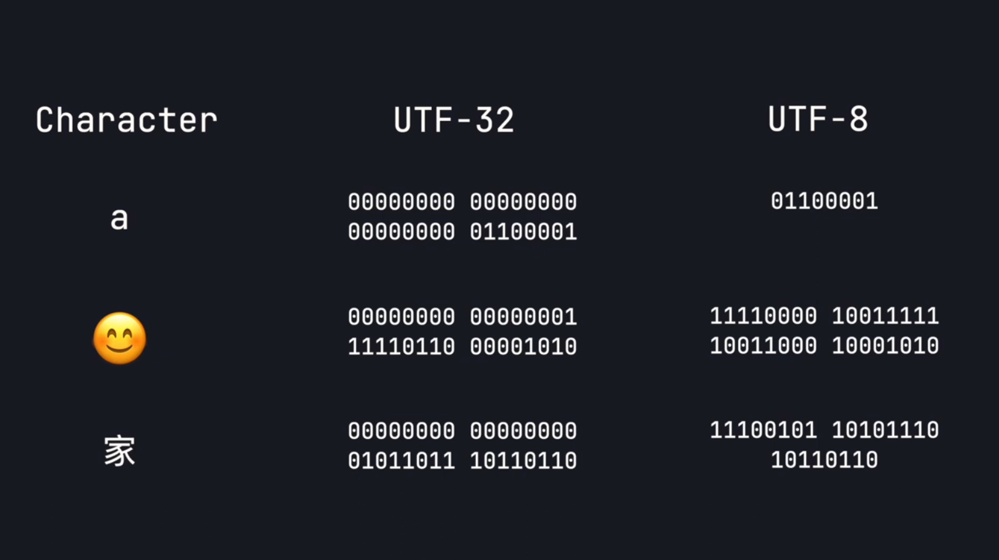
String:
var str string
str = "Hello, World!“
str := "Hello, World!"
length := len(str)
char := str[index]

Slide 68
Runes
single character
any language, including emojis and symbols
For example 'A', '好', or '♥’

Slide 69
Type inference
:= syntax or var =
the variable's type is inferred from the value on the right-hand side.
When the right-hand side of the declaration is typed, the new variable is of that same type:
var i int
j := i // j is an int

Slide 70
Functions:
func functionName(parameter1 dataType, parameter2 dataType) returnType {
// function body
}
A function can take zero or more arguments.
A function can return any number of results.

Slide 71
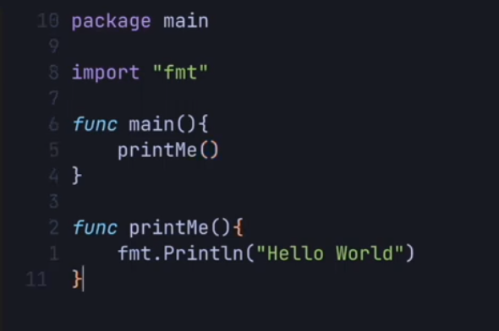
Functions:

Slide 72
Constants
Constants are declared like variables, but with the const keyword.
Constants can be character, string, boolean, or numeric values.
Constants cannot be declared using the := syntax.

Slide 73


Slide 74
If-else
if condition {
// Code to execute if condition is true
}
if condition1 {
// Code to execute if condition1 is true
} else if condition2 {
// Code to execute if condition1 is false and condition2 is true
} else {
// Code to execute if both condition1 and condition2 are false
}

Slide 75



Slide 76
switch statement
switch expression {
case value1:
// Code to execute if expression equals value1
case value2:
// Code to execute if expression equals value2
// Additional cases...
default:
// Code to execute if expression doesn't match any case
}

Slide 77

Flow Control
Go has only one looping construct, the for loop.

Slide 78


Slide 79
Flow Control
for initialization; condition; post {
// Code to execute
}
for {
// Code to execute
}
the init statement: executed before the first iteration
the condition expression: evaluated before every iteration
the post statement: executed at the end of every iteration

Slide 80

Flow Control

Slide 81

Flow Control

Slide 82

Arrays

Slide 83
Slices
dynamically-sized,
flexible view into the elements of an array.
provide a more powerful, convenient, and idiomatic way to work with sequences of data compared to arrays.

Slide 84
Slices
var sliceName []ElementType
var numbers []int
sliceName := []ElementType{elem1, elem2, ...}
numbers := make([]int, 5)
subSlice := sliceName[startIndex:endIndex]
copy(destinationSlice, sourceSlice)

Slide 85


Maps
unordered collection of key-value pairs

Slide 86
Struct
type StructName struct {
Field1 Type1
Field2 Type2
// ...
}
type Person struct {
Name string
Age int
}

Slide 87


Slide 88

Pointers
Special variables
that store the memory address of another variable
indirectly refer to a variable's value

Slide 89


Slide 90


Slide 91

Goroutines
lightweight threads managed by the Go runtime
concurrent execution of functions or methods
go functionName(arguments)

Slide 92


Slide 93


Slide 94


Slide 95


Slide 96



Slide 97

Error Handling
no try-catch block
manually handle errors
repetitive and boilerplatey code

Slide 98

Error Handling

Slide 99

Error Handling

Slide 100

Further learning

Slide 101


Slide 102
https://go.dev/doc/tutorial/
https://quii.gitbook.io/learn-go-with-tests/
https://www.youtube.com/playlist?list=PL5dTjWUk_cPYztKD7WxVFluHvpBNM28N9

Slide 103


Slide 104


Slide 105


Slide 106

Thank You

